Slide 1
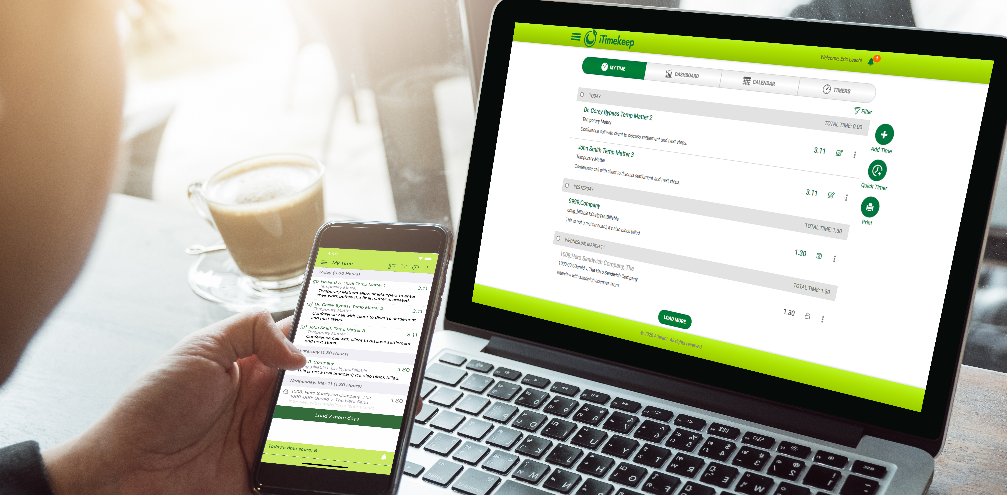
iTimekeep and OCG Live™ March 2020 Product Release

Slide 2
Our Vision:
More Value,
Same Simplicity

Slide 3
C-Level & Finance Professionals
With enhancements in both iTimekeep and OCG Live, law firms can achieve tremendous operational efficiencies and client satisfaction, by accomplishing something that was traditionally done through tedious, time-consuming and resource-draining manual work.

Slide 4
IT Professionals
This release allows the firm to continue to immediately push the latest and greatest innovations in time entry and compliance without taxing resources at the firm, incurring additional costs, or downtime.

Slide 5
Lawyers
Lawyers can now do much more with iTimekeep, while keeping the ease-of-use and simplicity to recover more time whether working on a mobile device or at the office. Lawyers now have compliance information at their fingertips, without the additional “noise” that doesn’t apply to them.

Slide 6
WHAT’S NEW
iTimekeep

Slide 7
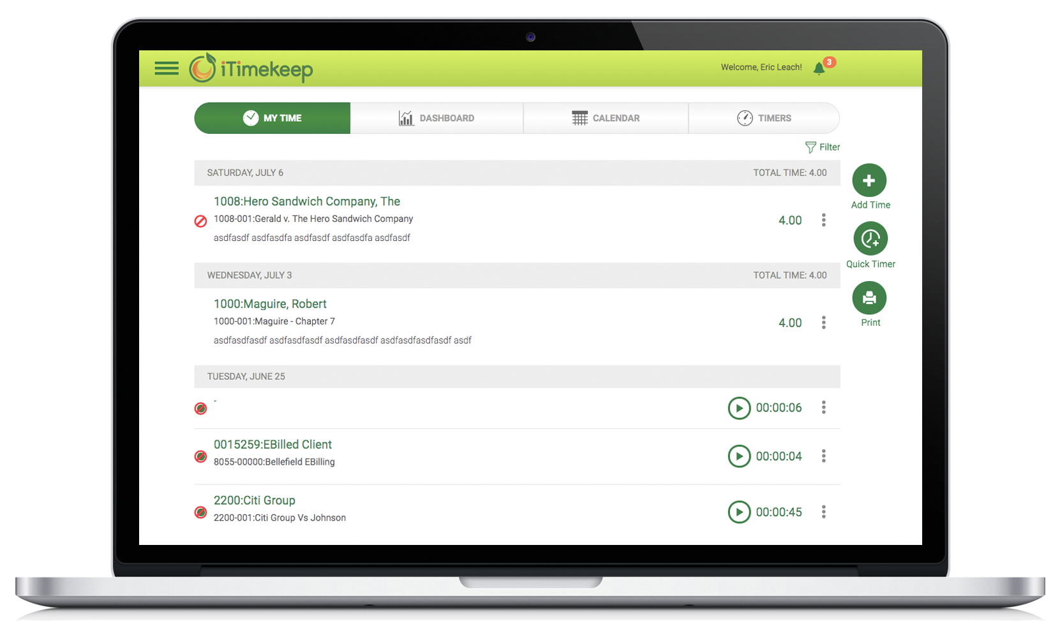
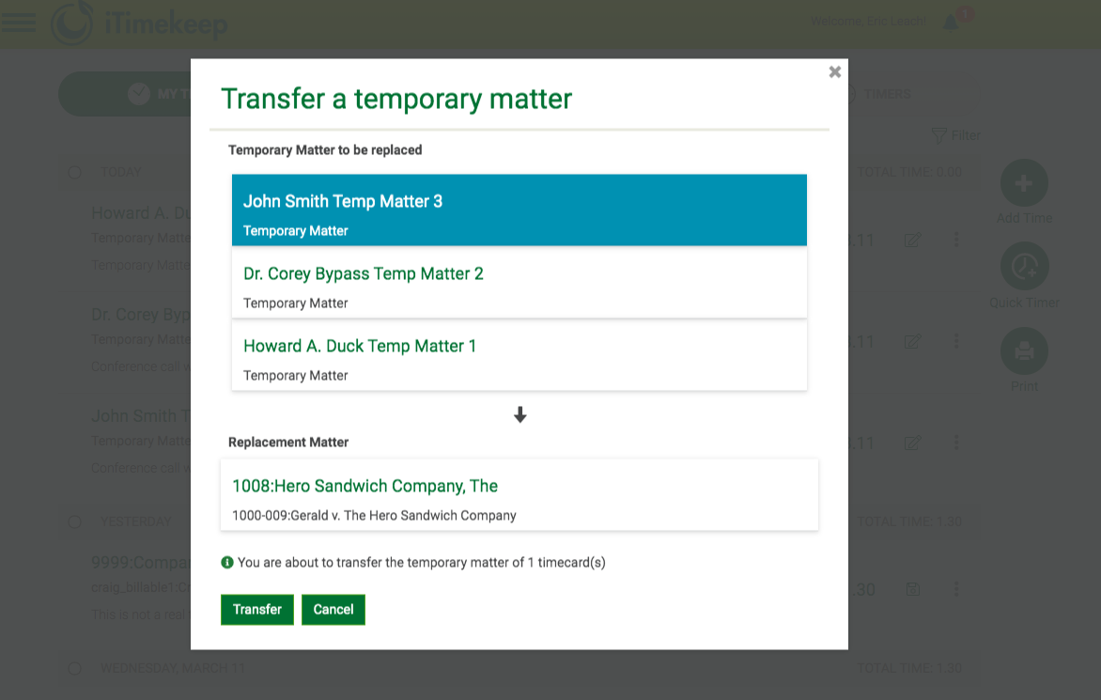
iTIMEKEEP
Start capturing time right away by quickly creating temporary matters.
Temporary matters can now be used in any draft timecard while waiting to obtain the final matter information. When ready, just convert the temporary matter to the actual one, and all entries will be automatically transferred.

Slide 8
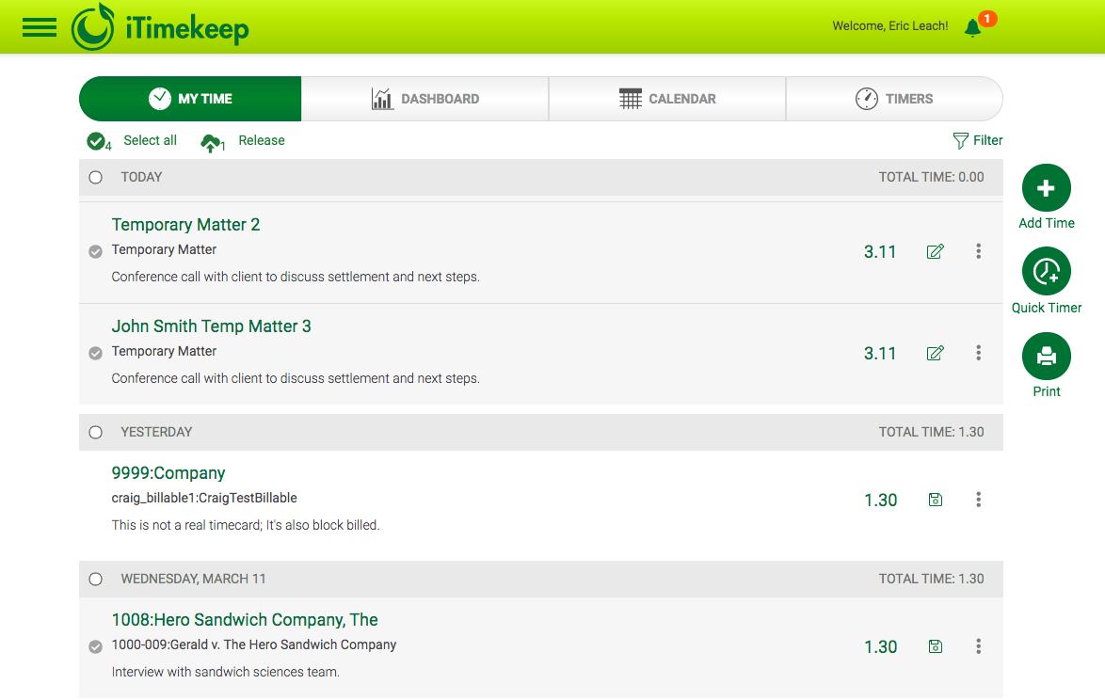
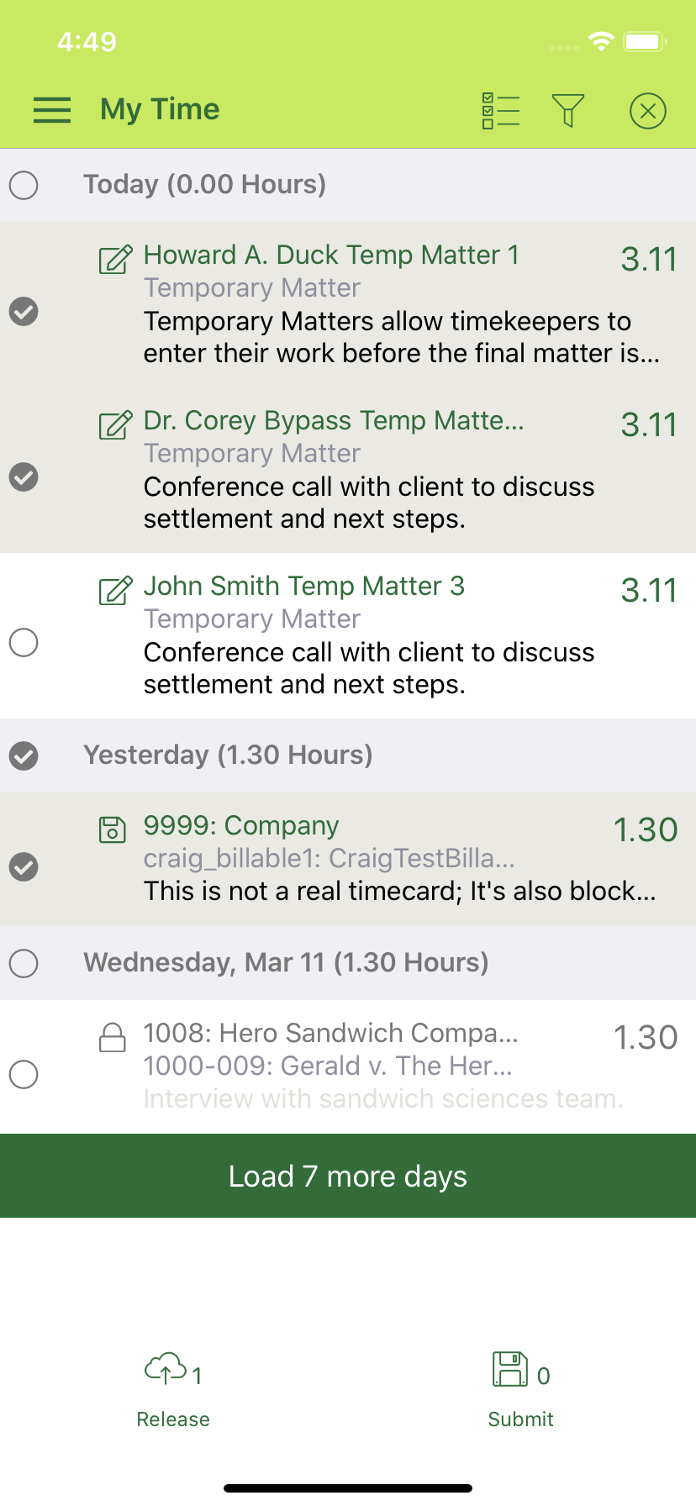
iTIMEKEEP
Submit and release time the way it best fits your workflow.
iTimekeep makes it easier and quicker to select entries for a given time period that you want to submit and release – one at a time, by the day, by the week, etc. Simply apply a filter, select the appropriate entries and release.

Slide 9
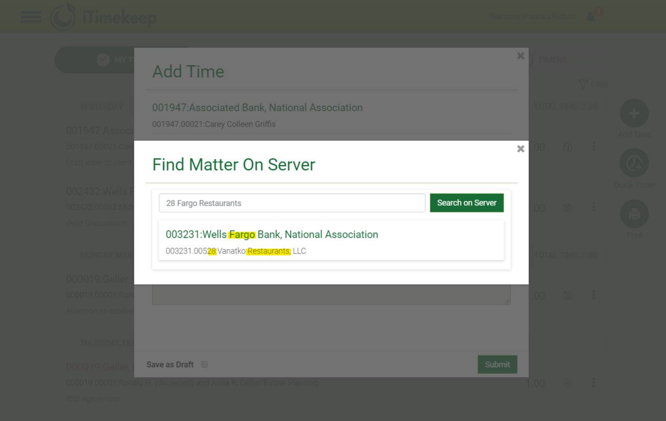
iTIMEKEEP
Find the matter you need, simpler and faster.
The intuitive and modern search experience in iTimekeep has been enhanced so that you can now type any words, in any order, that are contained in the matter or client (name, number, description, etc.) and immediately be presented with a list of matters matching that criteria.

Slide 10
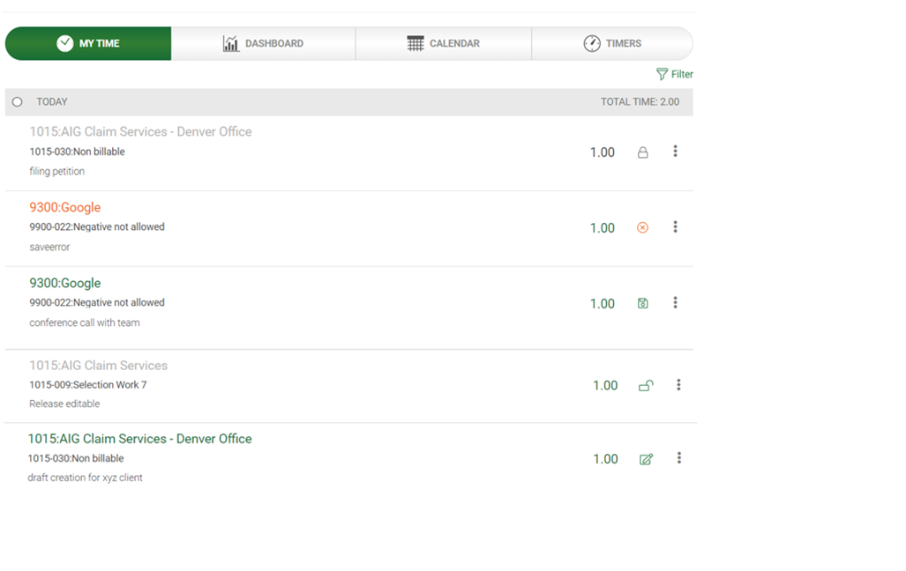
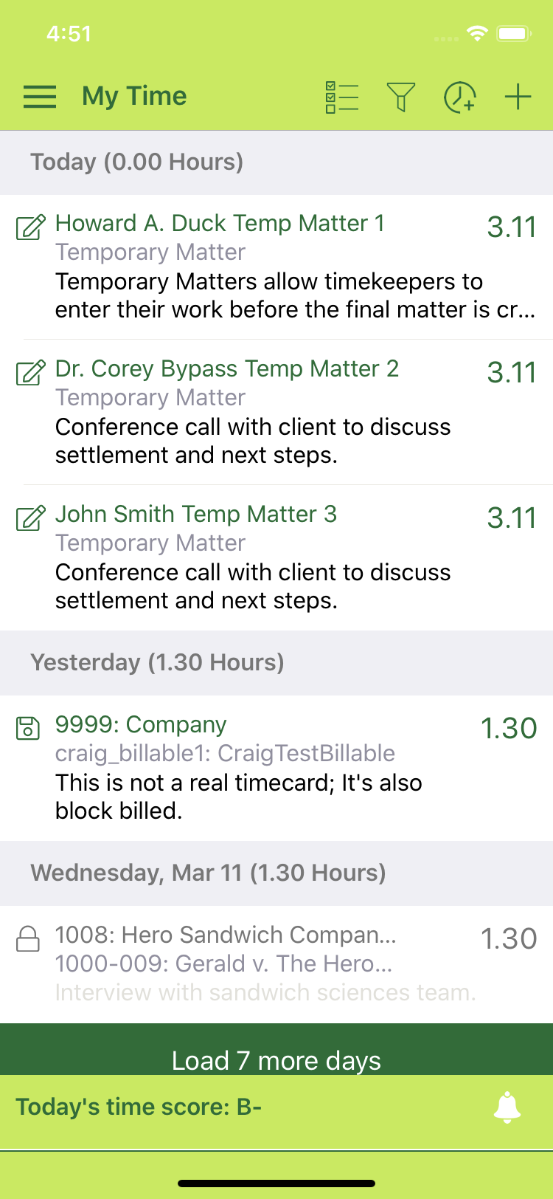
iTIMEKEEP
Quickly identify the timecard status through its lifecycle.
Since the lifecycle of a timecard goes through several stages, iTimekeep now uses icons and tooltips so you can quickly identify the current status of a timecard, and where it is its lifecycle – draft, submitted, released, etc.

Slide 11
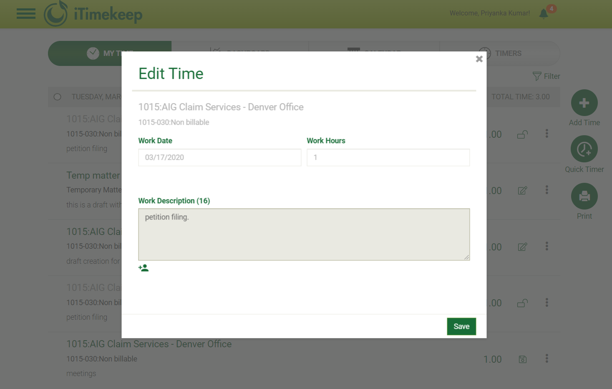
iTIMEKEEP
Edit Released Timecards up to Prebill.
Working in tandem with the Time and Billing systems, we now allow users to edit timecards up to the point that they are on a prebill – helping to streamline the prebill editing cycle. Level of editing is dependent on your Time and Billing system.

Slide 12
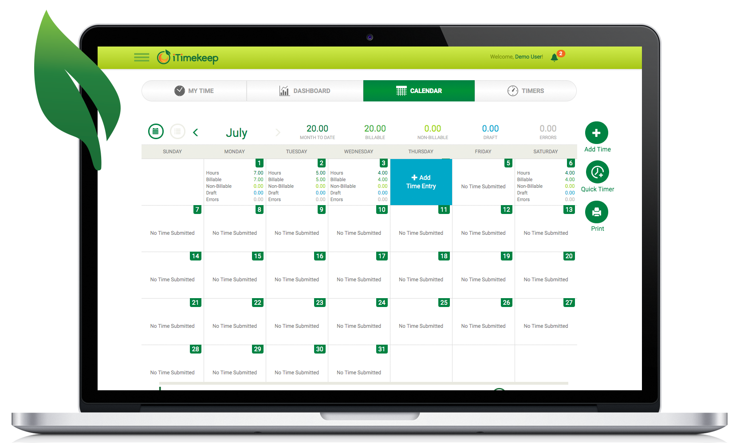
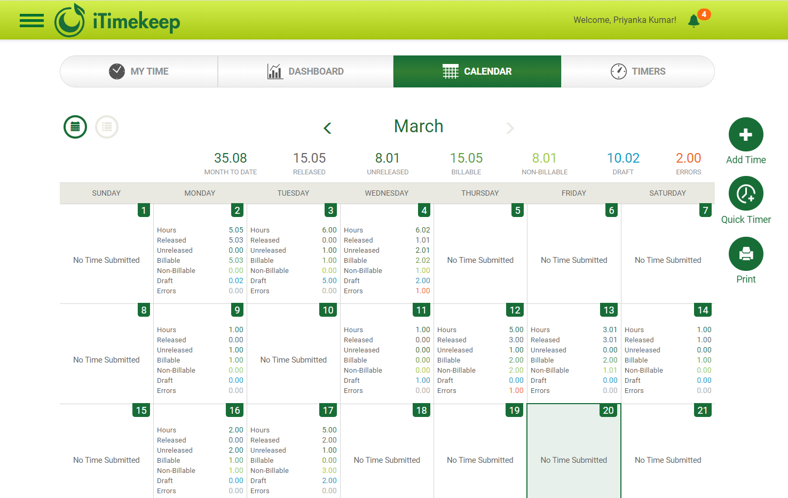
iTIMEKEEP
Calendar Shows Released / Unreleased.
Empowering the timekeeper to see from the calendar how much of their time is released/unreleased allows the user to be in full control of their time.

Slide 13
WHAT’S NEW
OCG Live™

Slide 14
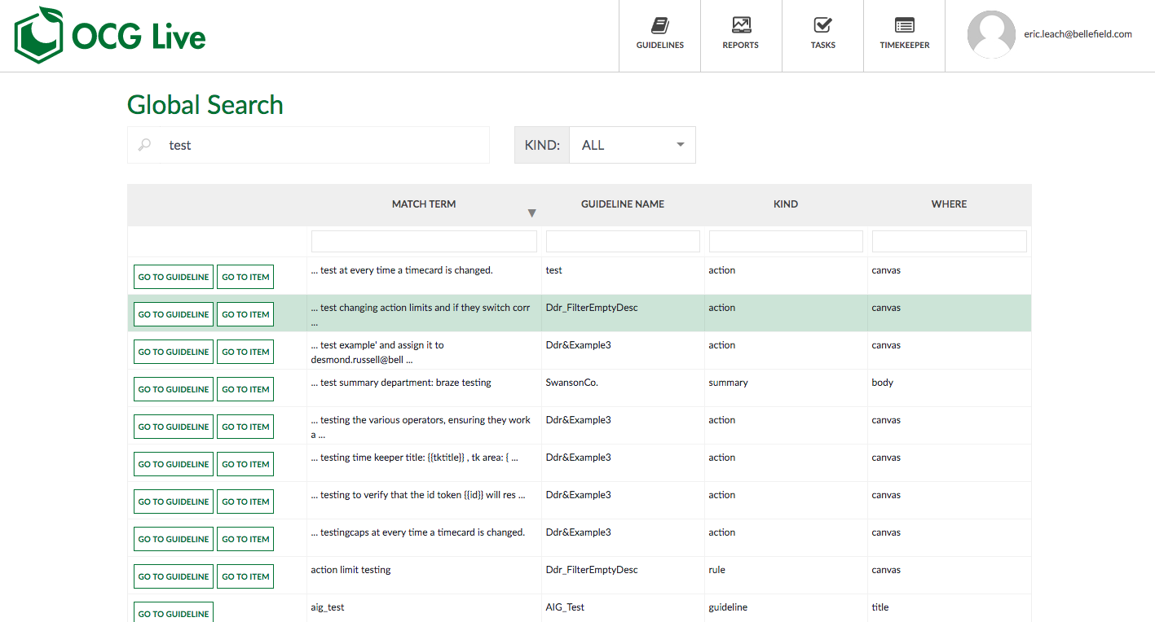
OCG LIVE
Find anything in OCG Live with supercharged global search.
The new Global Search of OCG Live allows firm admins to find any guidelines, rules, or summary data by just typing any search words. Search results present a list with appropriate matches found, grouped by category, with a link to quickly open the item for review.

Slide 15
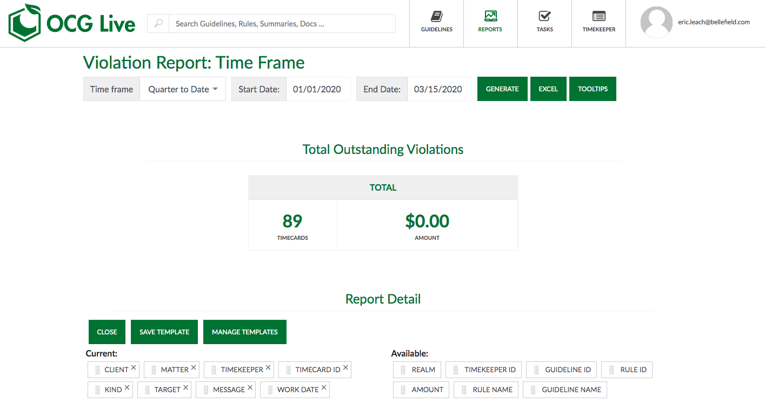
OCG LIVE
Enhance reporting to be in greater control of all OCG violations.
OCG Live customers can now report on violations, for any time frame, and aggregate all results into one view comprising all violations – including by timekeeper, on any given day within the timeframe. Users can customize and save the violations report “view” to display the report columns of interest to the user.

Slide 16
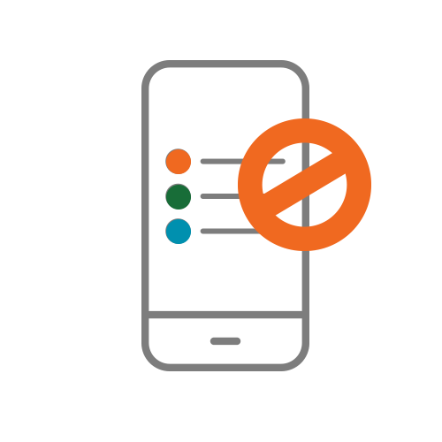
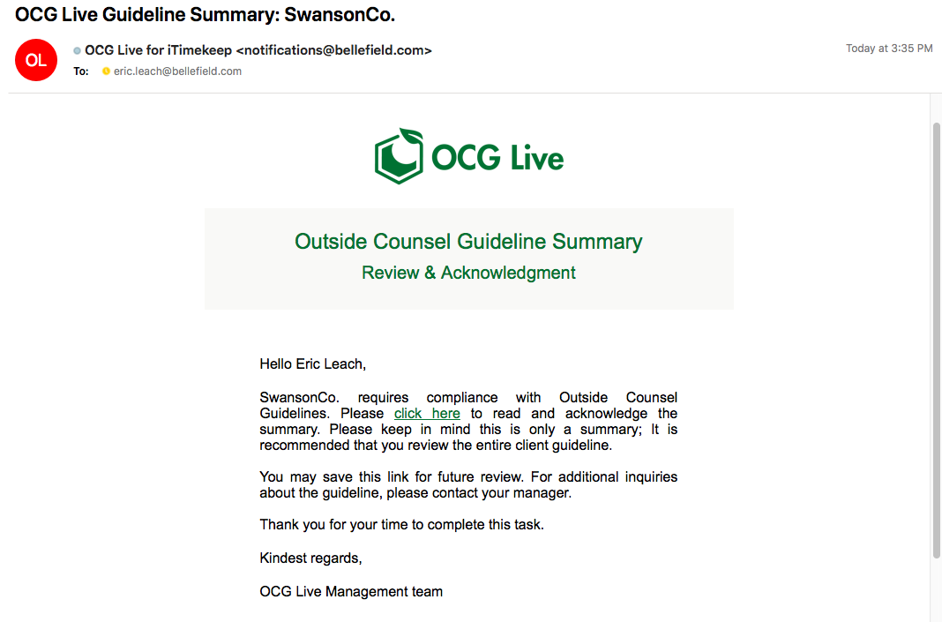
OCG LIVE
Live summaries and acknowledgement to automate attorney compliance.
Brings attorneys into compliance as soon as they start working for a client. OCG Live will engage with attorneys and present the relevant information they need to know, or actions they need to take, rather than overwhelming them with the entire set of guidelines.

Slide 17
Questions?
Visit resources.goaderant.com/ for more resources and be sure to reach out to your account executive or client success representative if you have any questions.

