Slide 1
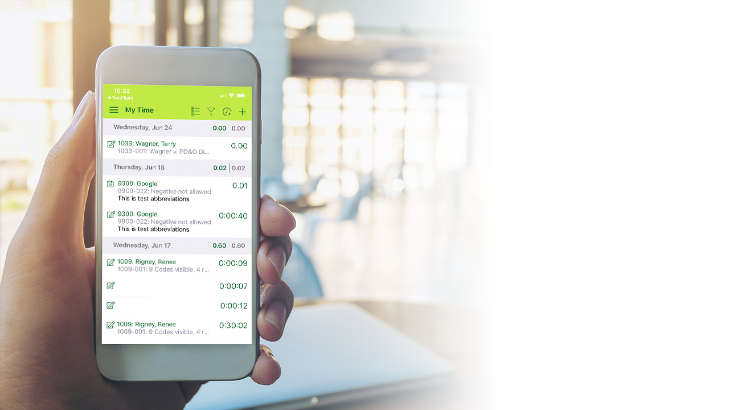
Visual Brief iTimekeep / OCG Live™
July 2020 Product Release

Slide 2
Our Vision:
Proactive Time Capture, Anywhere

Slide 3
C-Level & Finance Professionals
iTimekeep for Outlook is an extension of what lawyers do in Outlook today. Providing another avenue for lawyers to reduce time leakage as they capture more time contemporaneously from emails and events.
Ensure time captured is compliant with OCG’s. With more self-service reporting capabilities, lawyers can be more efficient in gathering appropriate data for internal or client discussions, alleviating requests to the finance team.

Slide 4
IT Professionals
iTimekeep for Outlook demonstrates the way the firm keeps up with innovation. Providing their lawyers with tools that are easy-to-use, work the way they work, from any app in which they are working.

Slide 5
Lawyers
iTimekeep for Outlook makes contemporaneous time capture easy by leveraging one of the tools they use most – Outlook. Lawyers who work on email day-in and day-out and do not typically enter their own time can take advantage of embedded iTimekeep capabilities to enter time right from Outlook and collaborate with their assistants to complete and post time.
This release also provides improved information access with enhanced reporting capabilities.

Slide 6
WHAT’S NEW
iTimekeep

Slide 7
iTimekeep: Highlights
iTimekeep for Outlook:
Requirements
iTimekeep for Outlook:
Create Timecard from Email or Calendar Event – Easily convert calendar events or email into timecards.
iTimekeep for Outlook:
Starting a Timer – Start a timer as you start writing or reading an email.
iTimekeep for Outlook:
Autofill Timecards – Make completing timecards even easier.
Enhanced Time Reporting –Improve lawyer self-service.
Time Entry Rounding – Flexible rounding options set by Firm Admin
Calendar View: Weekly Totals – Enhanced visibility
Quick Timers: Personalize Timer list to improve contemporaneous time capture.
Mobile – Improved timekeeping experience when having intermittent connection issues

Slide 8
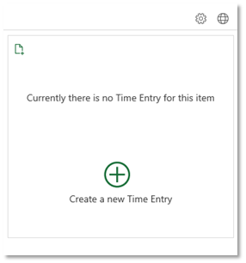
iTimekeep for Outlook: Create a Timecard
Easily convert calendar events or email into timecards
From the email or calendar event, select the iTimekeep icon from the ribbon bar.
If no timecard has been created yet, click ‘Create a new Time Entry’ to add an entry for the email/calendar event.
If there is a timecard for the email/calendar event, the timecard will be displayed.
Note: Timecards are saved automatically as draft anytime a change is made. User needs to deliberately submit.

Slide 9
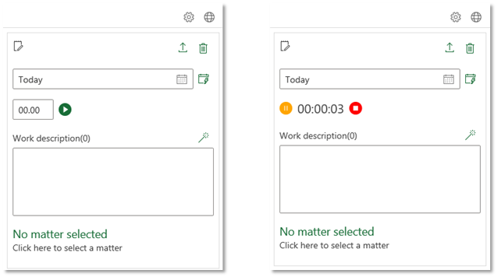
iTimekeep for Outlook: Starting a Timer
Start a timer as you start reading or writing an email
From the timecard user can select the ‘play’ icon to start a timer and interact with timer controls.
Same behavior currently in iTimekeep.
User Setting option is available to have timer start automatically.

Slide 10
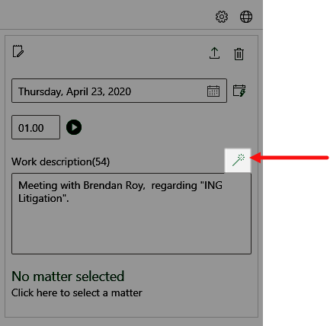
iTimekeep for Outlook: Autofill timecards
Make completing timecards even easier
From the email or calendar event, select the ‘magic wand’ icon above the Work Description box to populate the narrative.
Data utilized to populate narrative includes:
Recipients
Subject Line
User Setting option is available to default suggested narrative.
Note: Template used by the add-in is not exposed on the front-end or configurable.

Slide 11
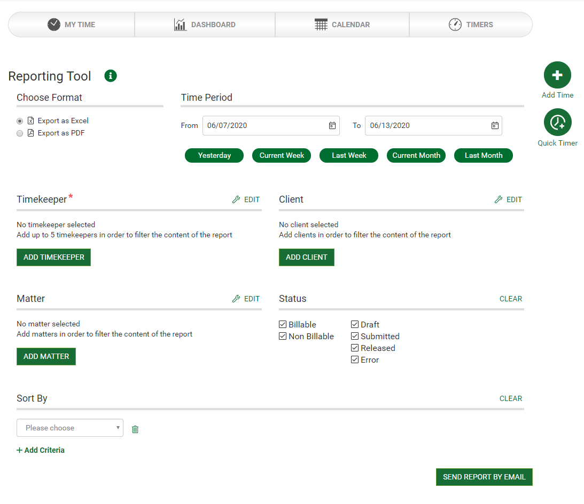
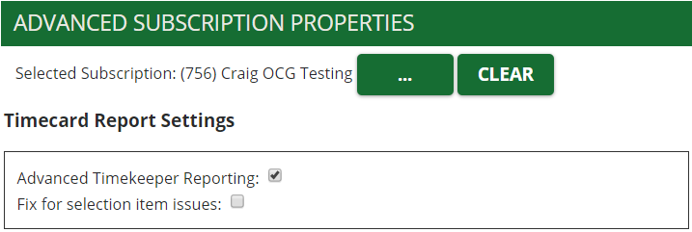
iTimekeep: Enhanced Time Reporting
Increased reporting flexibility within this known interface
Additional criteria and formatting options allow you to tailor the request to exactly what you’re looking for, without additional manipulation once the report is available.
Enabled in the Portal > Advanced Subscription Properties
Note*: Timekeepers will only be able to report on themselves. When a timekeeper accesses enhanced reporting the Timekeeper section will not be visible.

Slide 12
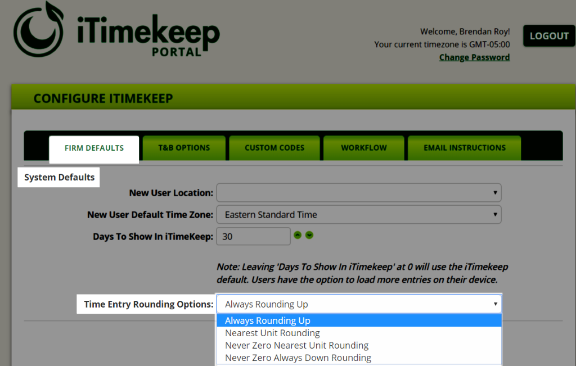
iTimekeep: Time Entry Rounding
Increased options for firm-specific time rounding
Administrator can set the rounding option for all time entries to one of the following, based on the firm-defined rule:
Always Rounding Up
Default – rounds up to the nearest time increment (current behavior)
Nearest Unit Rounding
Rounds to the nearest increment, up or down
Never Zero, Nearest Unit Rounding
Rounds to nearest increment but will not round down to 0.00
Never Zero, Always Down Rounding
Rounds down to the nearest time increment but will not round down to 0.00
Note: Rounding is set in the Portal and applies across all devices. Firm Setting

Slide 13
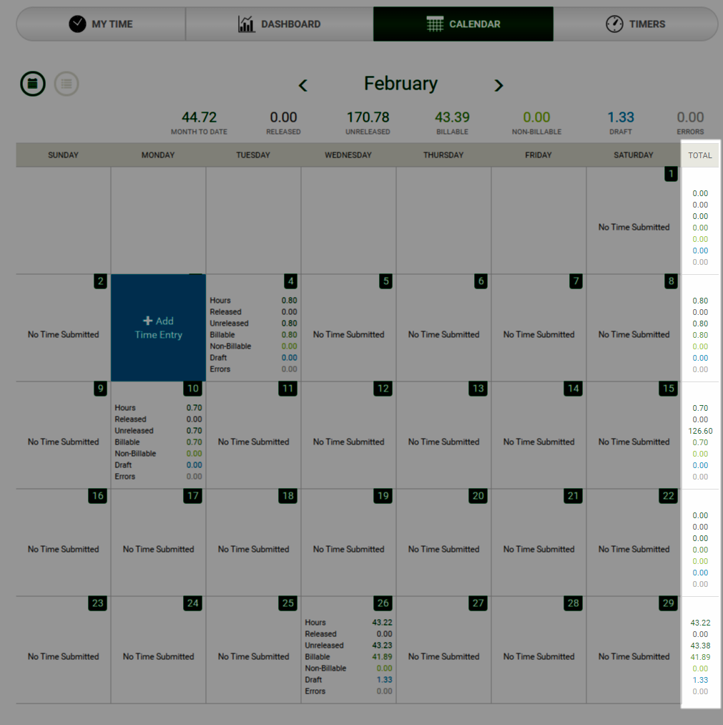
iTimekeep: Calendar View – Weekly Totals
At a glance easily view weekly totals
Empowers lawyers to see weekly totals without needing to manually add up the values.
Available in desktop only.
Cannot hide or remove weekly totals.

Slide 14
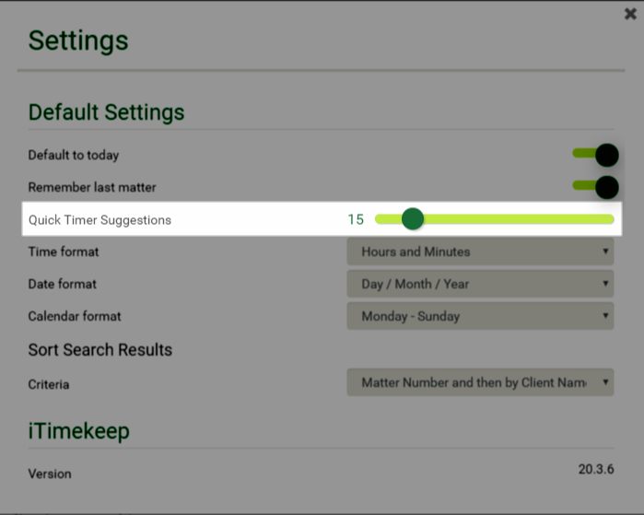
iTimekeep: Quick Timers – User Setting
Improve contemporaneous time capture
Quick Timer Suggestions by default is set to 10.
Max configurable limit of 50
Increments by 5.
Note user cannot manually enter a value – must select via the slider.
Note: text

Slide 15
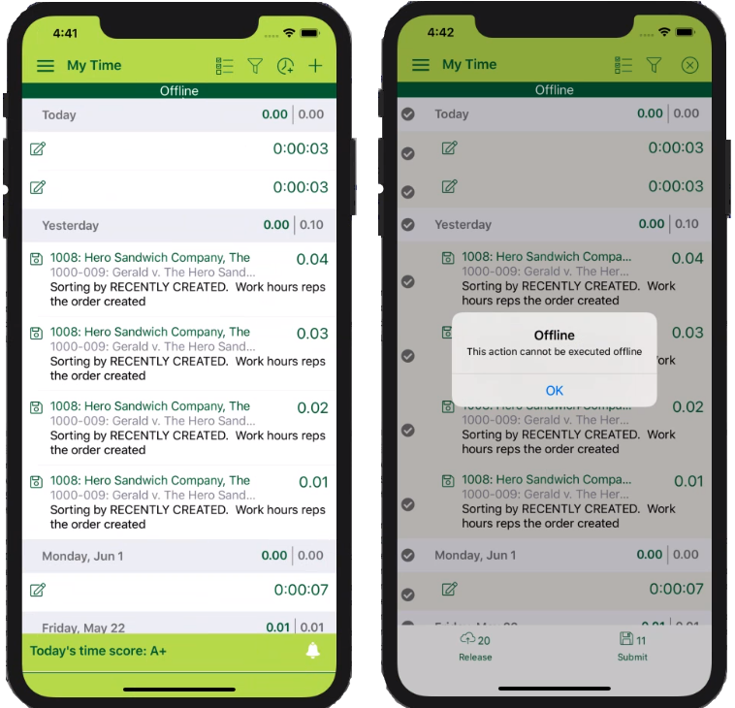
iTimekeep Mobile: Connection Drop
Maintain productivity & capture time during temporary connection issues
Notification that you are offline
Manage and create new timecards
Create and interact with timers
Create new short cuts and temporary matters
Receive a notification prompt to sync data when mobile device is back online
Note: Depending on the mobile model – the app cache may last up to ~2 hours if the app remains open in the background. This will vary based on a host of factors

Slide 16
WHAT’S NEW
OCG Live™

Slide 17
OCG Live: Release Highlights
Violation Report includes time entry narratives Bring time entries into compliance faster. Enables the individual responsible for correcting the time entry to see the narrative that needs to be brought into compliance.
Enhanced Task Management New multi-selection and mass action capabilities provide OCG Admins the ability to easily manage task lists for assignment, completion and more.

Slide 18
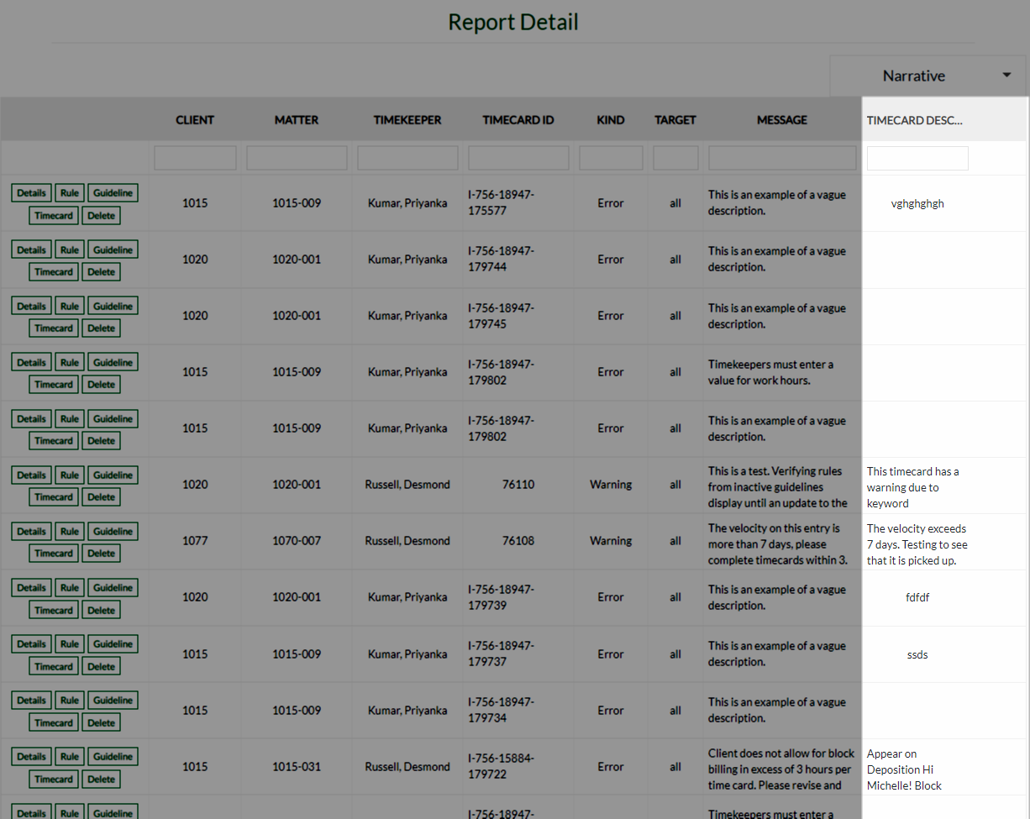
OCG Live: Violation Report includes Narrative
Bring time entries into compliance faster
Timecard narratives will have a dedicated column in the Violations Report.
Note: In-line editing is not possible.

Slide 19
OCG Live: Enhanced Task Management
Streamline management of OCG Live Tasks and Acknowledgements
Improved user experience to easily manage task lists for assignment, un-assignment, completion and more.
Multi-selection and Mass actions
Embedded filtering
Additional columns
Navigation highlight

