Slide 1
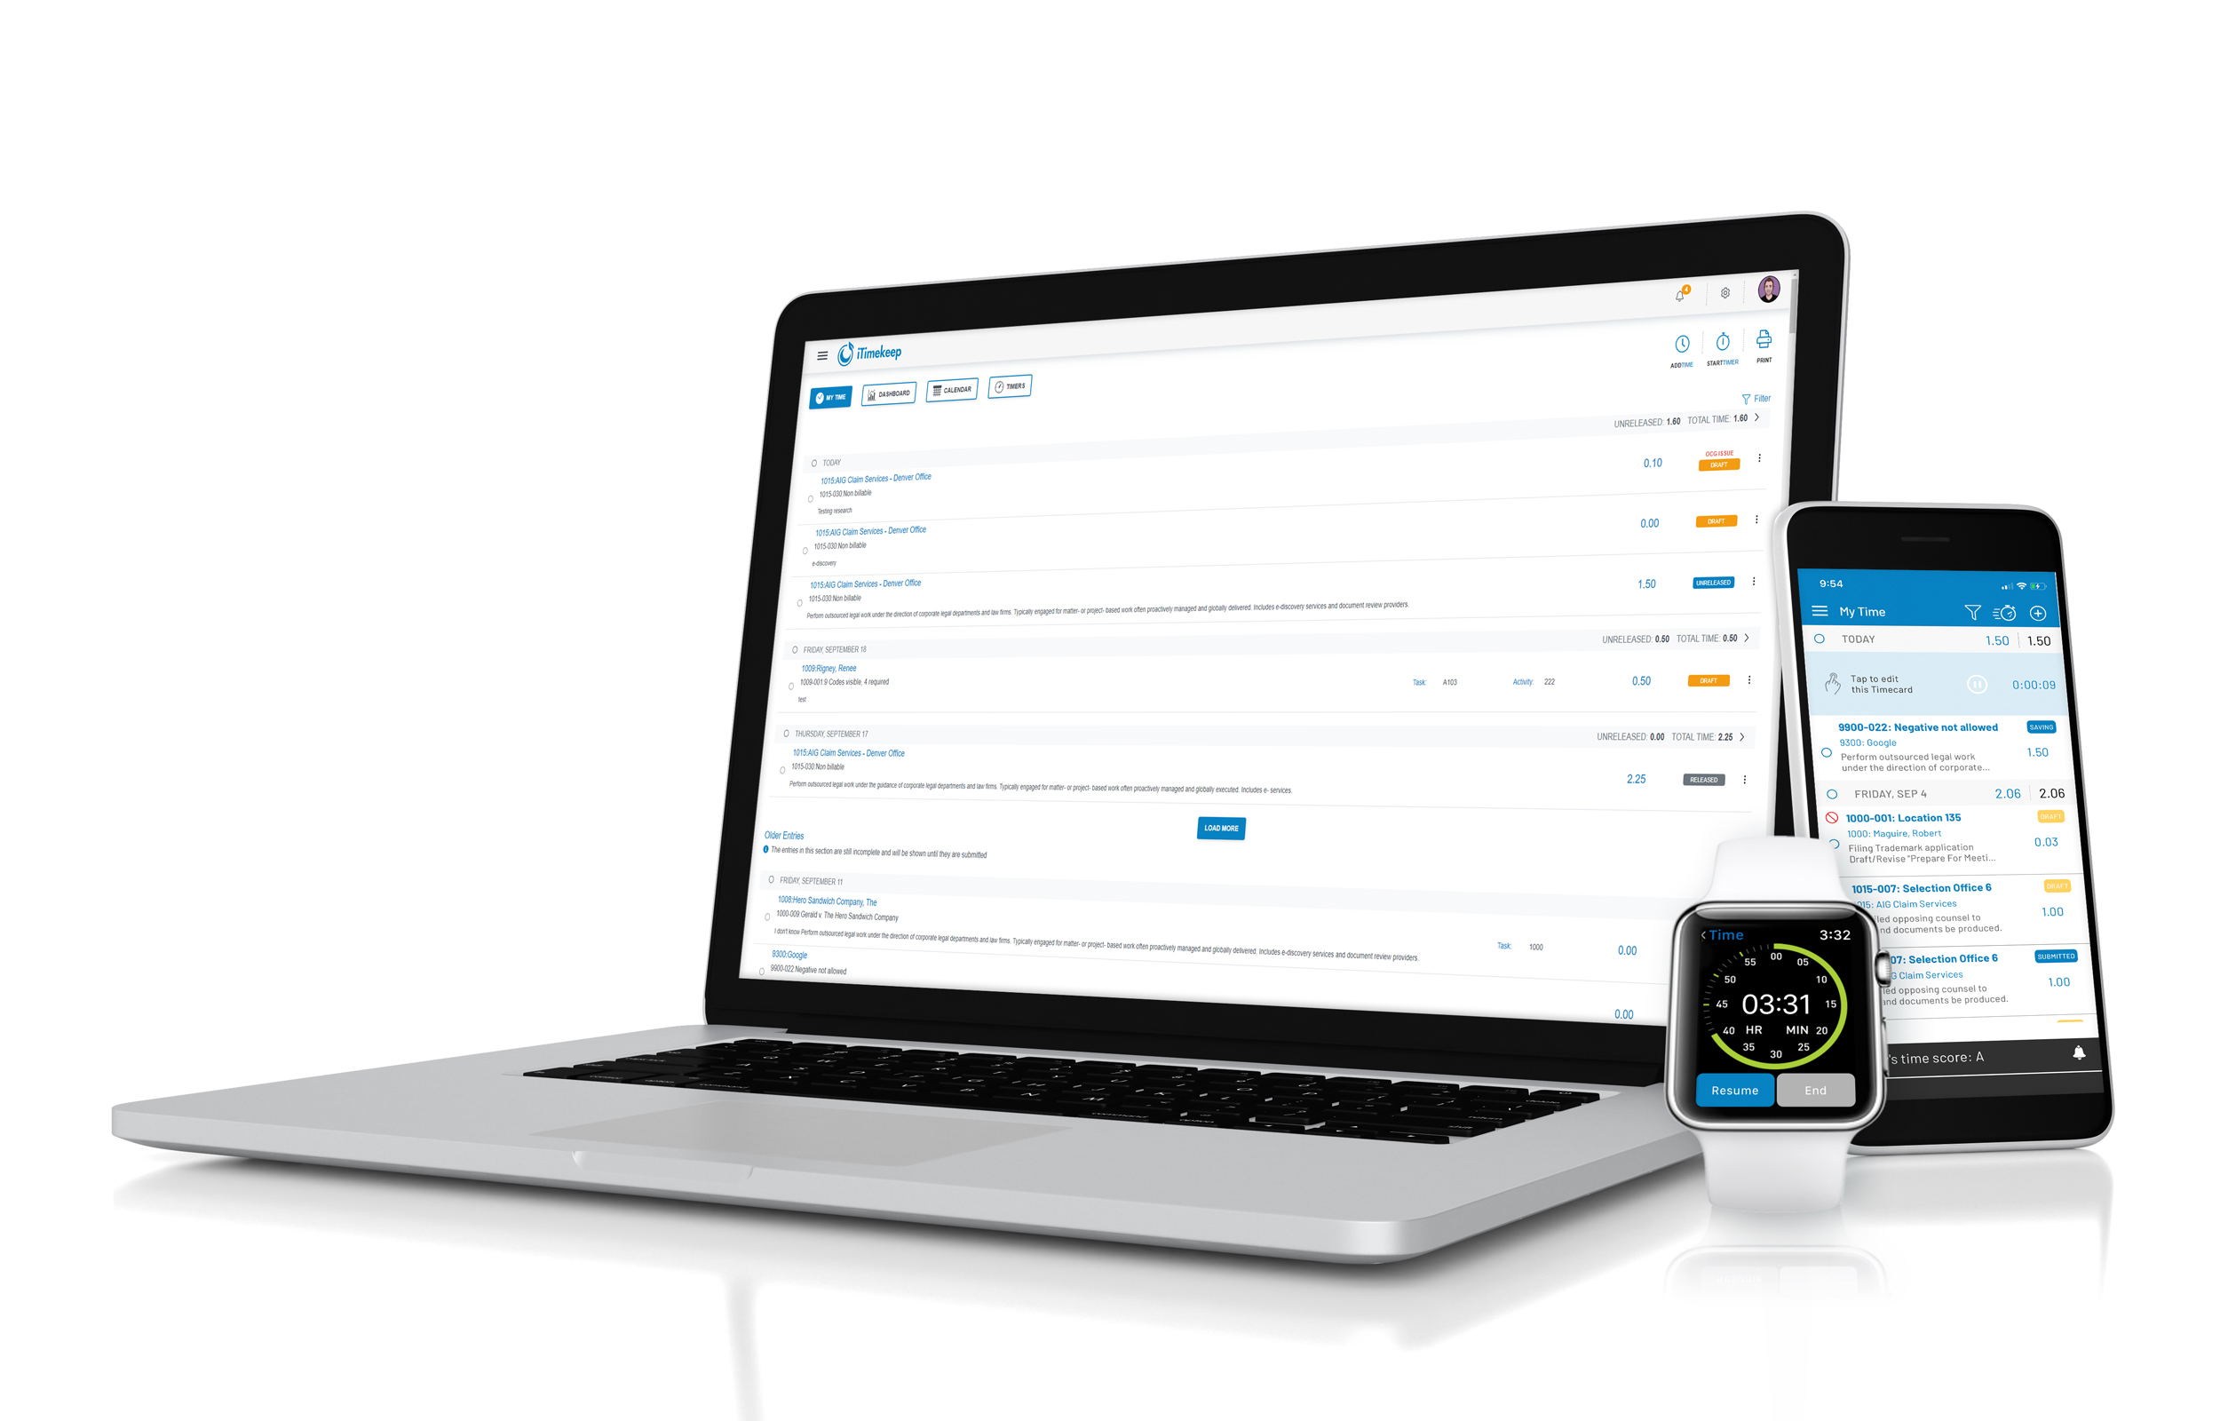
Visual Brief iTimekeep / OCG Live™ / Thrive
October 2020 Product Release

Slide 2
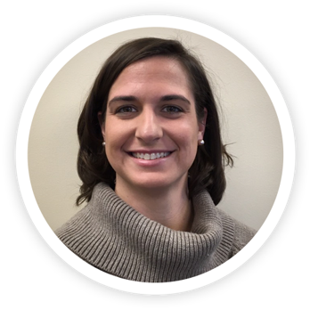
Introduction
Presentation by: Tara Quinn, Manager of Account Management
Notes:
Hello, my name is Tara Quinn and I will be your presenter today. I am honored to be given the opportunity to present another exciting release of iTimekeep and OCG Live. I’ve been doing these release webinars for clients for over a year now and it is truly amazing to watch the evolution of the product. Consistent with previous new releases, we have included additional capabilities that have been requested by YOU, our existing clients. We are active in our user community and love to hear from our timekeepers and firms using iTimekeep on how we can improve the experience and make time entry even easier! And a wonderful client of ours had a great quote I want to share, “The time it takes to enter time should not take longer than the time worked.”
So, let’s jump into our Q2 release!

Slide 3
Our Vision:
Create a culture of compliance

Slide 4
C-Level & Finance Professionals
Help create and manage timekeeping policies and achieve firm compliance.
Measure performance, understand firm trends, and take corrective action using Thrive's intuitive reports and dashboards.
Ability to comply with audits and produce a record for the client to demonstrate the discipline of the firm and its commitment to compliance.
Notes:
For C-level and finance professionals, Thrive introduces the ability to help create and manage timekeeping policies and achieve firm compliance. Measure performance, understand firm trends, and take corrective action using Thrive’s set of intuitive reports and dashboards.
See who are your timekeeping rockstars and those who need some encouragement.
This release perpetuates iTimekeep as the premium time entry and compliance platform. With the enhancements in both iTimekeep and OCG Live, law firms can achieve tremendous operational efficiencies and client satisfaction, by accomplishing something that was traditionally done through tedious, time-consuming and resource-draining manual work.
For the head of practice and financial managers, this release is all about the ability to comply with audits and produce a record for the client to demonstrate the discipline of the firm and its commitment to compliance.

Slide 5
IT Professionals
Continue to immediately push the latest and greatest innovations in time entry and compliance without taxing resources at the firm, incurring additional cost, or downtime.

Slide 6
Lawyers
Compliance – lawyers are always "in-the-know." Have at their fingertips just the information they need without "noise."
Expediting correction of time entry violations to ensure rapid billing cycles = fewer invoice rejections and faster payments.
Personalization of iTimekeep promotes the simplicity and ease of use with a tailored experience unique to their timekeeping behavior.

Slide 7
WHAT’S NEW
iTimekeep

Slide 8
iTimekeep: Highlights
Unified User Experience
Personalizing iTimekeep
Duplicate Entire Day of Time Entries
Thrive Goals in iTimekeep
Additional Timecard Info in My Time/Timers
Highlight Non-Compliance in Narrative
Notes:
Here are the highlights of the iTimekeep release. We will get into the details of these features in the next few slides.

Slide 9
Unified User Experience
Notes:
The iTimekeep suite of products – iTimekeep, OCG Live and Thrive get a facelift with an updated, modern and consistent user interface. A sleek, clean user experience that optimizes screen real estate, streamlines navigation and application flow and ensures consistency across all products, promotes increased usability and ease of use.
We love building new functionality that makes a big impact on the way you use iTimekeep. Over the last few years, we have brought you sophisticated capabilities — such as iTimekeep Outlook Add-in, and more. But we also know how important it is to continually improve what we have already built.
In addition to the more modern look and feel, you can easily show and hide data to reduce visual noise while you are working, and we updated the application font for improved text legibility.
Consistency across iTimekeep, OCG Live, and Thrive:
Sleek, clean user experience optimizing screen space
Streamlines navigation and application flow
Modern, consistent user interface across iTimekeep platform

Slide 10
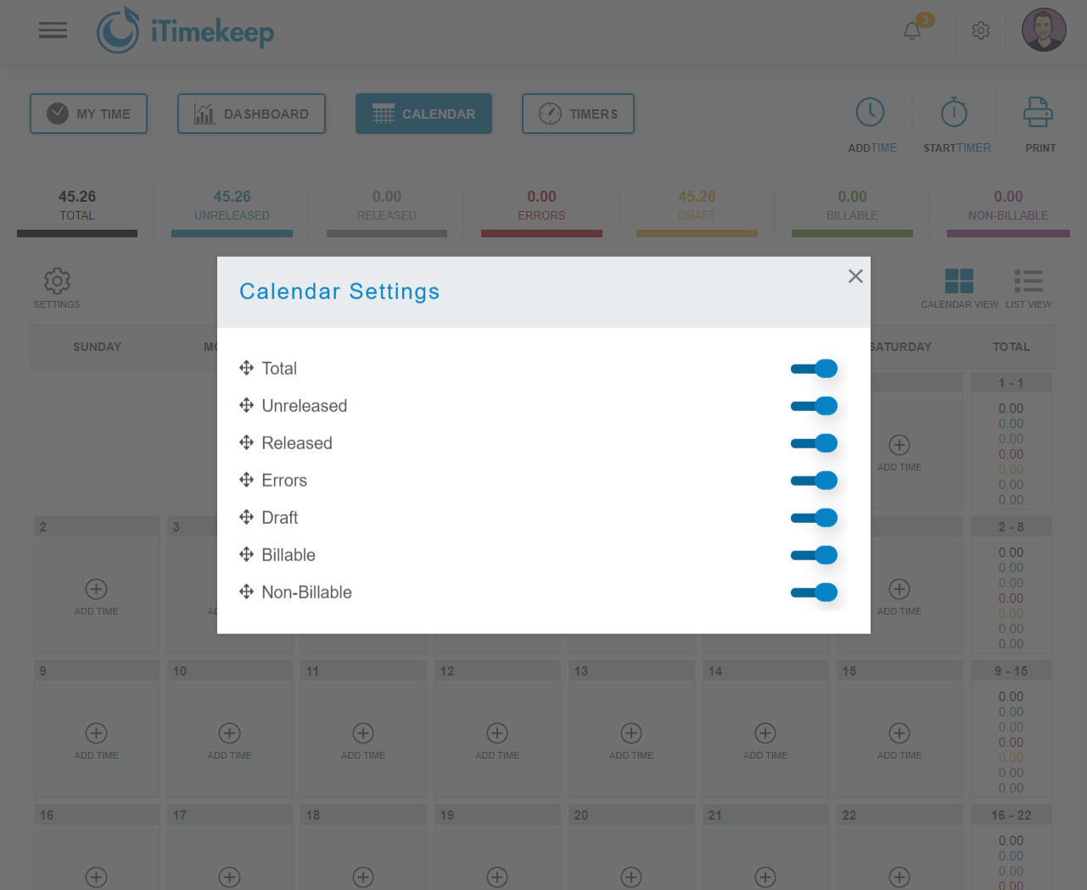
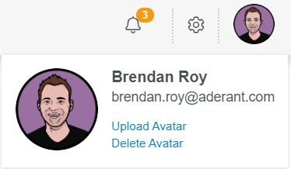
Personalizing iTimekeep
Allow users to customize the experience to best meet their timekeeping behavior
Tailor the user experience for optimal usage and increased ease of use:
Avatar Photo
Theme
Calendar categories
Notes:
Theme selection extends across the suite of products. So the theme selected in iTK will be visible if/when the user opens the mobile app, OCG Live, and Thrive.

Slide 11
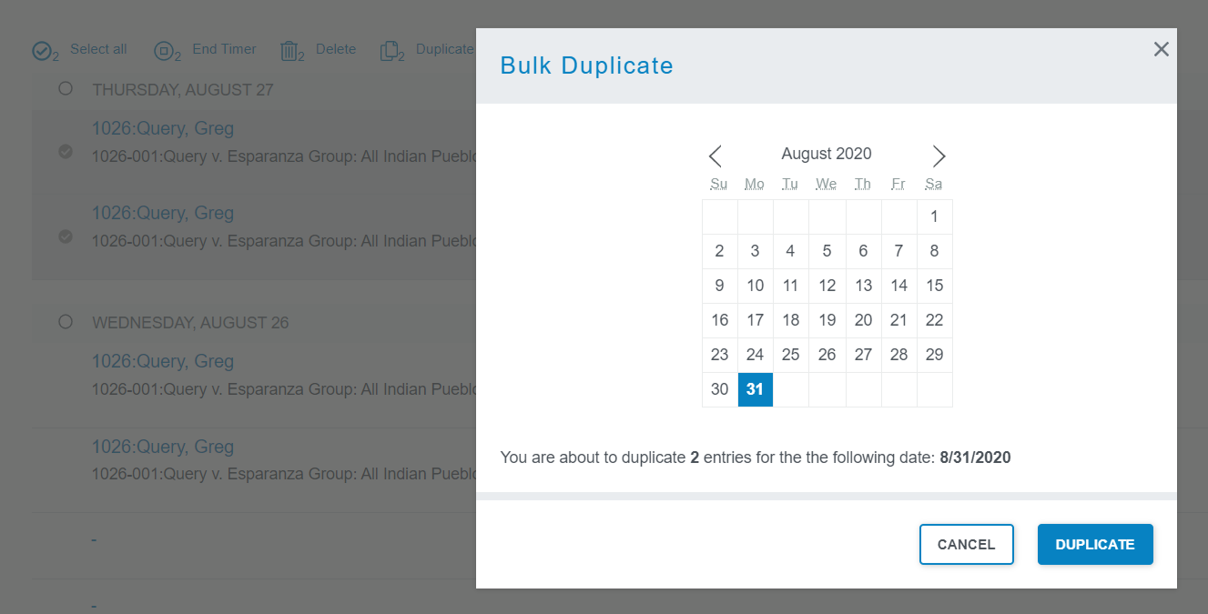
Duplicate an Entire Day of Time Entries
Keeping focus on making time capture less burdensome
Streamline entry for similar activities with extended duplicate timecard functionality:
New mass actions
Duplicate
Delete
Notes:
Timekeepers now have the ability to duplicate an entire day’s worth of time entries if they want – able to enter time more efficiently and faster.
Can be done on Desktop or Mobile.
Scenario –
The attorney does Complex litigation and every week is required to generate and submit a strategic report to the client for all of their matters. So on Sunday the attorney completes the task. This is not a daily task but something performed once or twice a week.
The LGC client wants our entries divided out over all the cases and we have several buckets depending on what we are working on where the client is the same, but the matter is different and sometimes the time is different but the description is the same. It would take too much time to have to go in and tweak the matter by just duplicating the one entry as I would still have to do that 42 times (the number of active cases goes up and down sometimes weekly depending on what settles and what new cases come in) so this is a real issue and priority to make sure we can do this in iTimekeep.

Slide 12
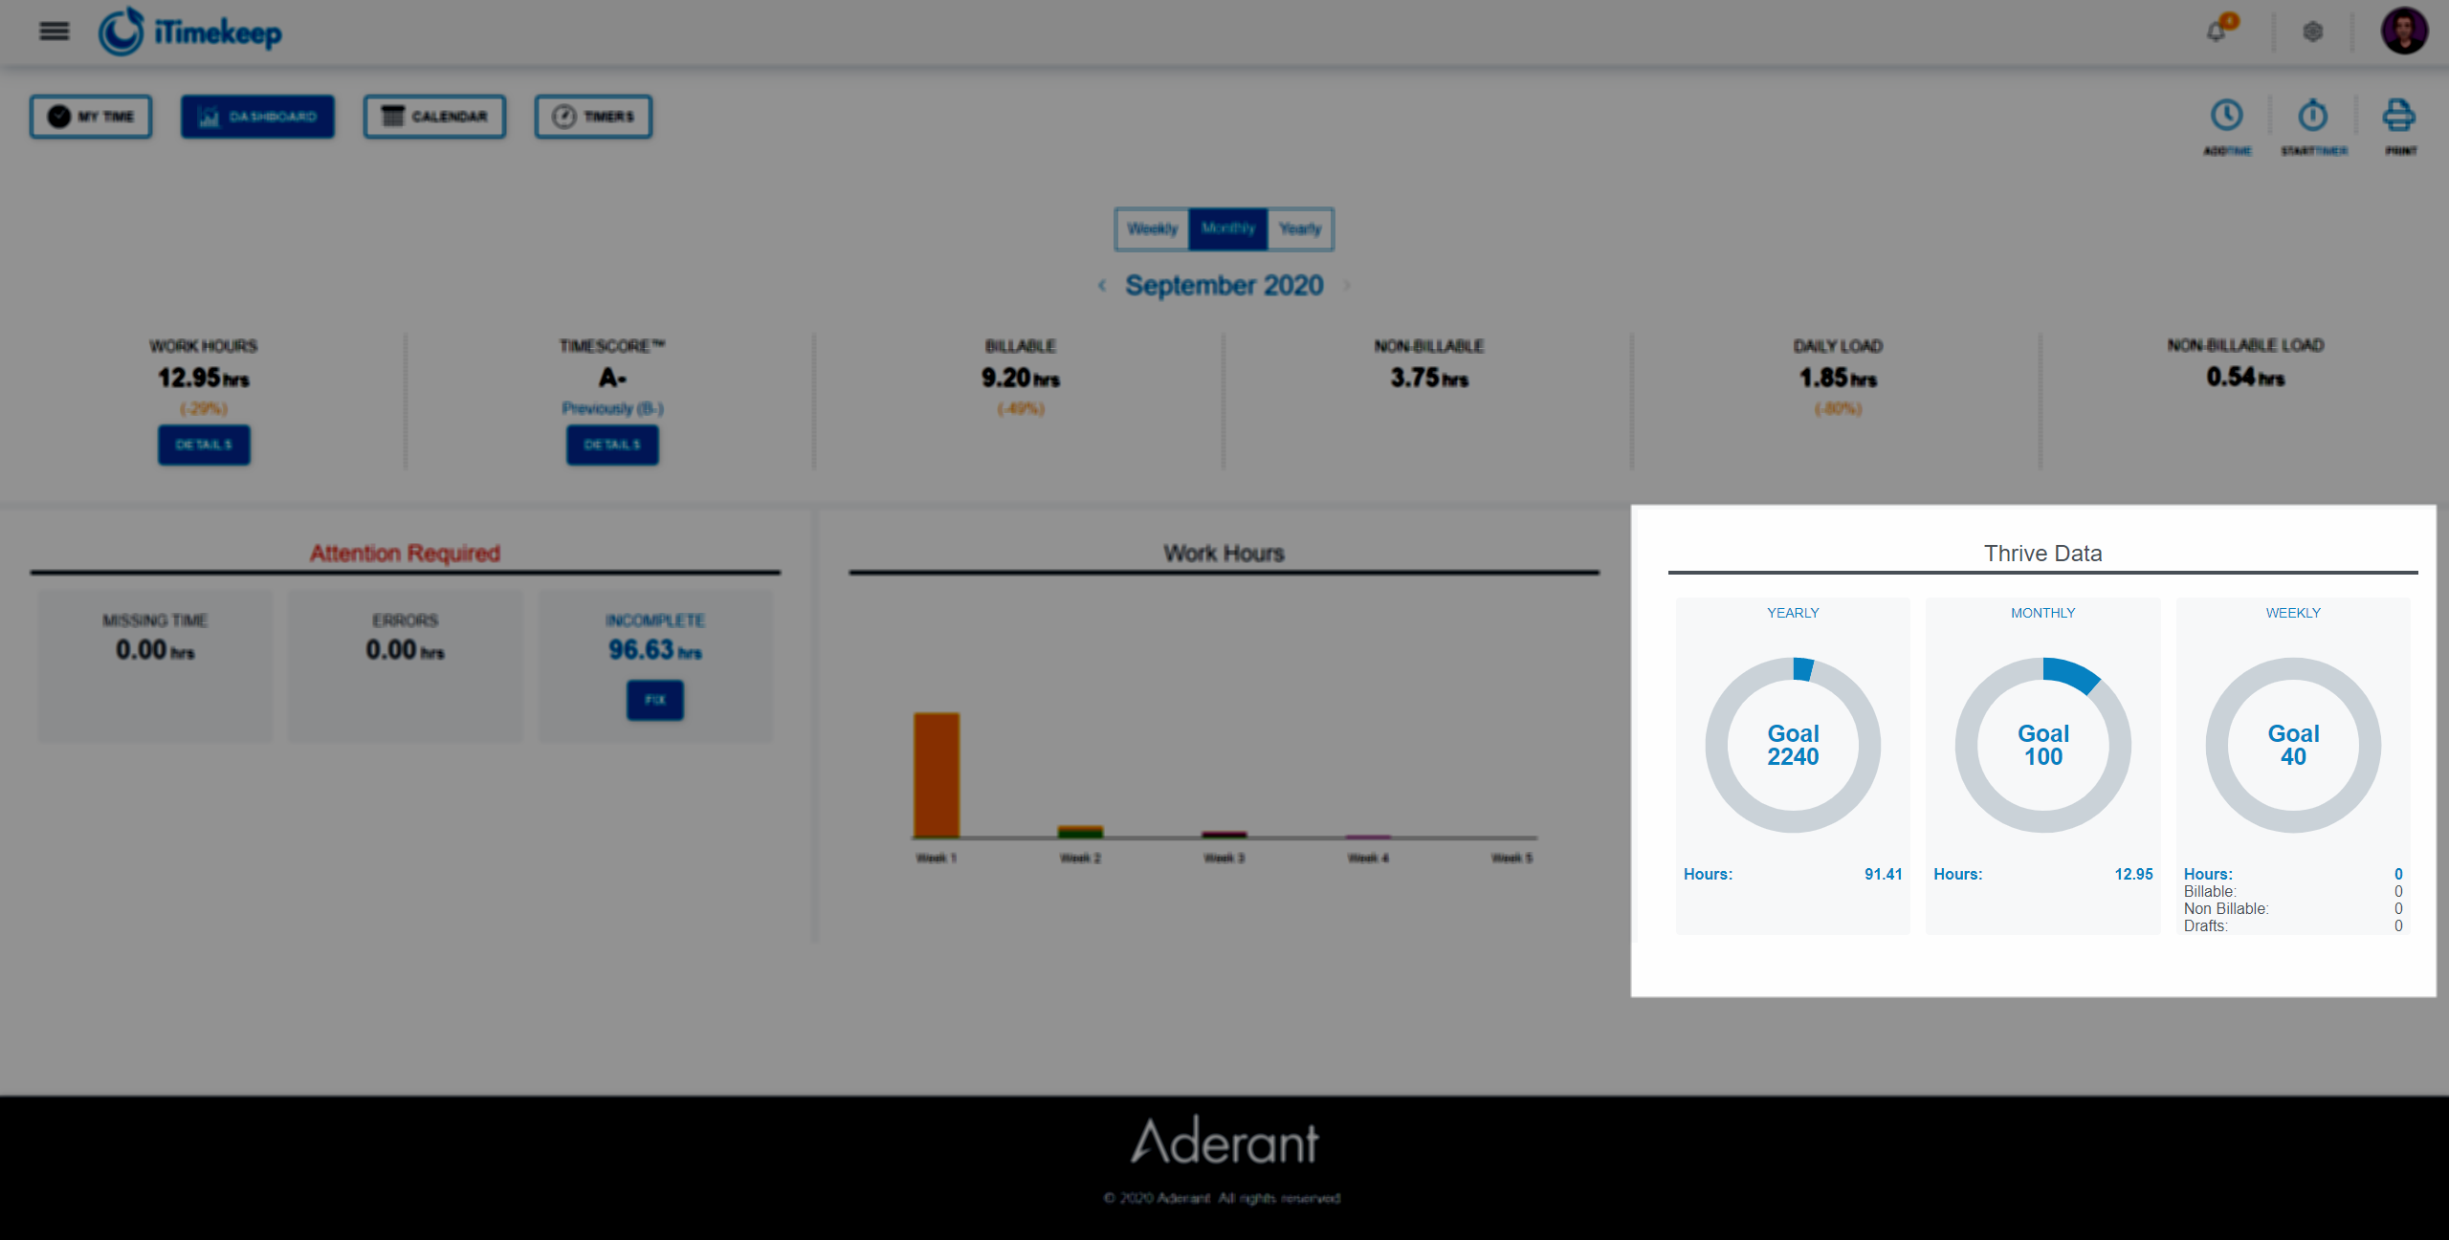
View Thrive Goals in iTimekeep
Effectively track and monitor targets vs. actuals in iTimekeep
Compliance data available inside iTimekeep:
Track progress against monthly/ annual goals
Constant awareness and visibility of targets
Note*: Thrive section will only be visible if Thrive is licensed, user is Thrive Timekeeper and attached to an active policy.
Notes:
Benefits/ Added Value:
Better timekeepers: we want to help timekeepers become better timekeepers thru immediate engagement and guidance
Proactive: we want to prevent bad behavior and to help attorney correct their behavior before it is too late. To ensure users are notified of problems as they occur (ex. missing time), and be given the ability to immediately remedy the problem before they fail the policy.
No more Delayed actions: timekeepers must wait till the end of the month to see where they fell short or achieved their goal. There is no real time engagement.

Slide 13
Display Additional Timecard Data
Note*: Requires latest version of Connect.
Improved visibility of data during timecard review and editing
Optimize use of screen real estate to show important timecard information:
Firm configuration setting
Select up to four (4) codes to display in My Time and Timers views
Notes:
From a timecard review and management perspective this will significantly improve efficiencies, allowing the timekeeper to see all the relevant detail, at a glance, without any additional actions. No need for additional discovery.
iTK Admin (Home) Portal > Configure iTK > Firm Defaults > (Scroll Down) Selection Items to Display in My Time [ Need to hold Ctrl to select multiple. Just shows the codes – not description.
Use Case:
I need to combine my time spent on the same task code into a single time entry with semicolons between each different thing (as shown below – this is a cut and paste from my Excel spreadsheet), and it’s a pain to do this in iTimekeep, particularly because I can’t see without opening up each entry what task code it is.
Real Time/Google
28082-70007
L120
Review Google and Realtime tutorial presentations and patents (3.0); analyze filings in related cases and IPRs for relevance to infringement and claim construction arguments (1.7).
4.70

Slide 14
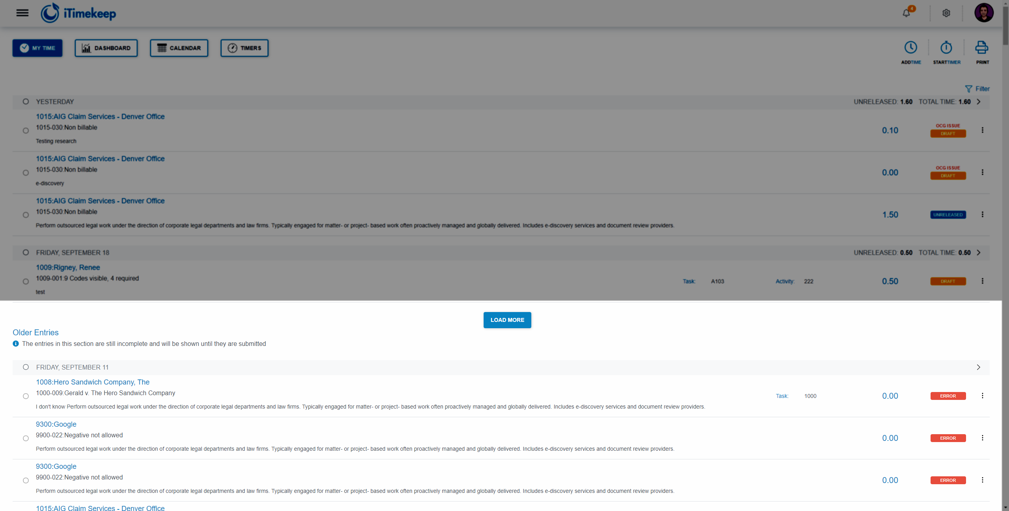
Older Entries
Improved clarity of information when viewing time entries
Defined new Older Entries section in My Time.
Removes confusion when only Incomplete Time is displayed beyond firm’s default timeframe.
Note*: As users select ‘Load More’ days in ‘Older Entries’ will move into the main list and show all time entries for the day being viewed.
Notes:
In the past clients struggled with the fact that based on a firm setting, iTimekeep only showed all entries for a defined number of days before only showing unsubmitted time. Lawyers were concerned and going wait a minute – I entered more time than this! Where is the rest of my time?
We have improved this by rebranding this behavior as ‘Older Entries’ to show that this section highlights timecards that still need to be actioned.
As a timekeeper or legal assistant, I want to see all time entries I entered rather than just draft entries so that I am no longer confused and concerned that I am missing time entries.
There is confusion in the market today because I cannot see the time entries I entered because they were older than 7 days. The confusion is that I can see a draft entry dated for June 8th, but not see the time entries between June 8th and July 6th.

Slide 15
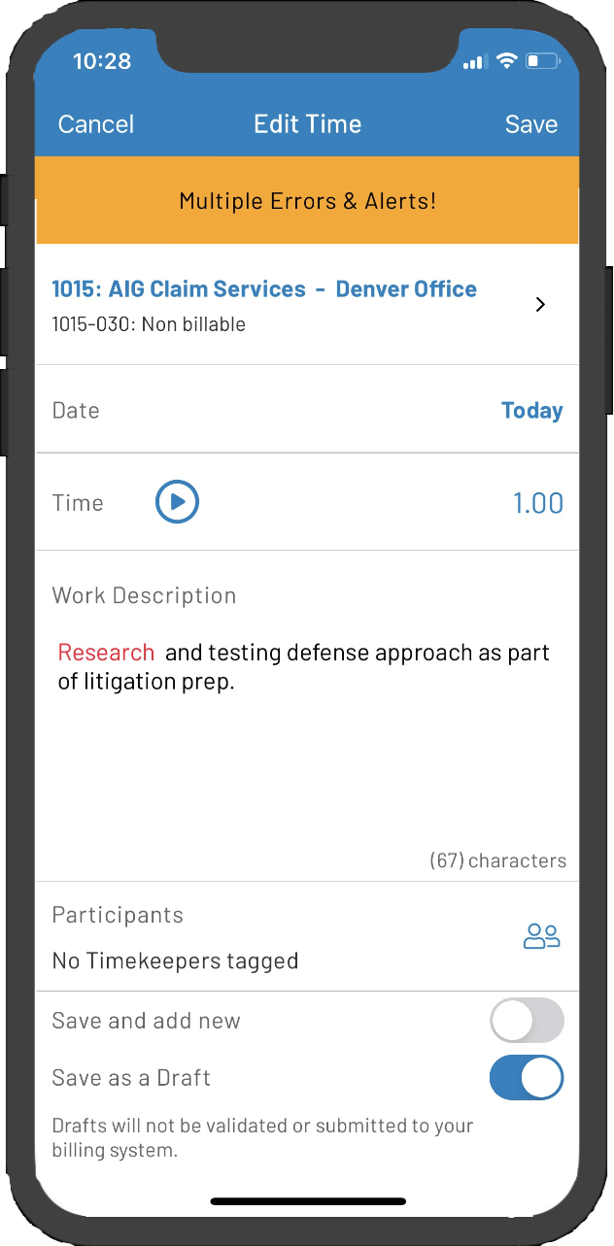
Highlight Non-Compliance in Narratives
Immediate notification of OCG violation reason
Trigger word(s) highlighted in timecard for correction.
Takes place as part of Point of Time Entry (PoTE) validation
Requirements:
OCG Live license
Correct Guideline setup
Notes:
4.70
Know the What along with the Why.

Slide 16
WHAT’S NEW
iTimekeep- Demo

Slide 17
WHAT’S NEW
OCG Live™

Slide 18
OCG Live: Release Highlights
Violation Report: Highlight Trigger Word & Reason OCG Live Violation Reports now find, highlight and identify the violation reason so they can be more easily corrected.
Extended Summaries Ensure all departments are "in-the-know."
Create summaries for other departments such as Information Security, Human Resources, Marketing, etc., and keep them engaged as part of the entire compliance process.

Slide 19
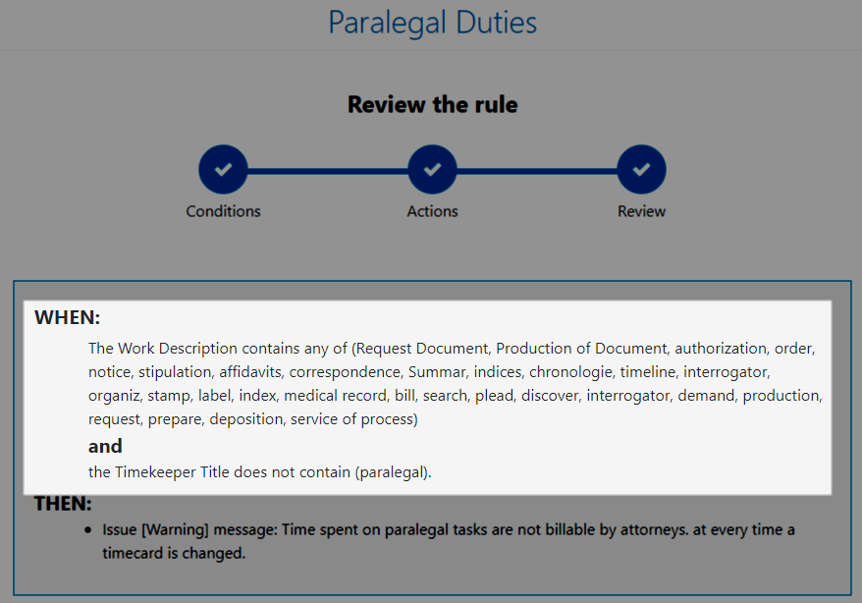
Highlight Trigger Word & Reason
Immediately identify the violation reason so they can be easily corrected
Trigger Words - will be highlighted in the work description column
New Violations Report column Reason – displays the cause of the Violation (When defined for the rule)

Slide 20
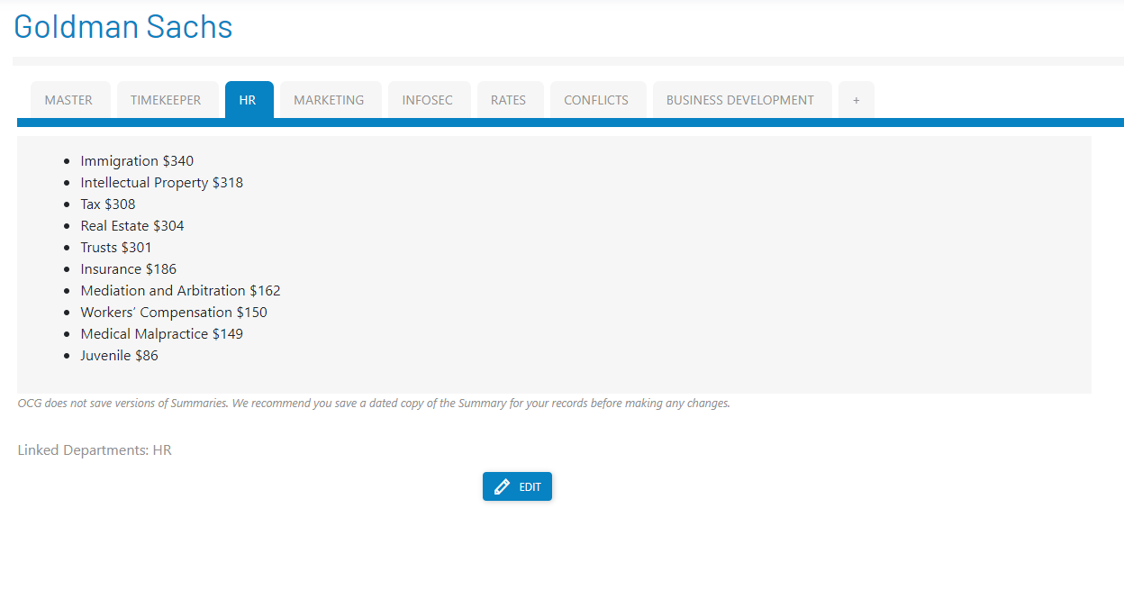
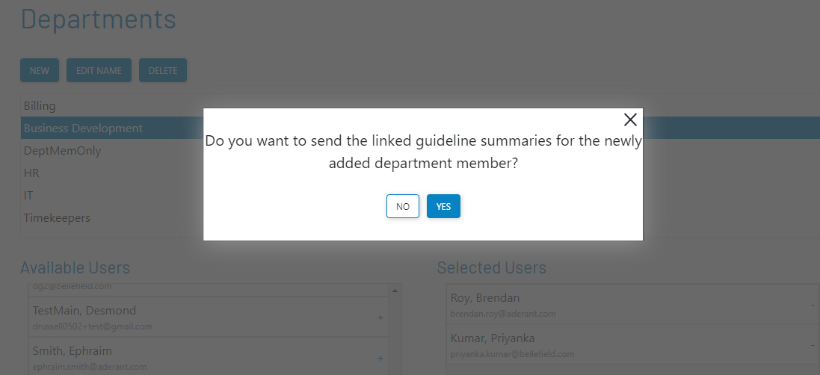
Extended Summaries
Bring other departments into compliance
Extended ease of compliance to other departments:
Create summaries for other departments, increasing visibility and awareness
Send acknowledgement to new department members when department is linked to a guideline

Slide 21
WHAT’S NEW
Thrive

Slide 22
Thrive: Release Highlights
Real-time Compliance Data & Interactive Reporting Ensures near-real time data is available for immediate reporting and analysis.
Multi-policy Management One size does not fit all.
Create multiple, bespoke policies that can be tailored to you as a firm as well as the employees assigned to it.
Engage with Timekeepers and Policy Owners Multi-faceted solution focusing on engaging timekeepers to ensure alignment to their goals.

Slide 23
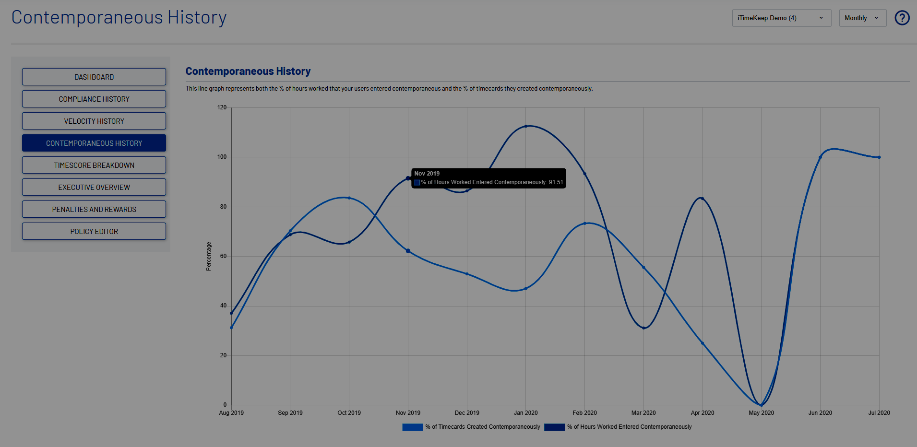
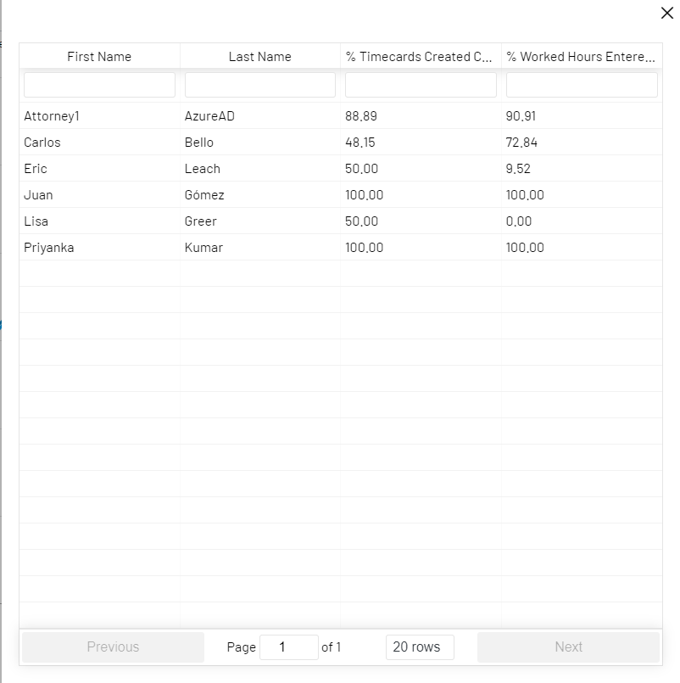
Real-time Compliance Data & Interactive Reporting
View actionable reports instead of waiting until end of the month
Additional timeframe reporting rather than just monthly
Daily / Weekly / Monthly
Tracking performance across numerous attributes
Drill-down to view details
Export user results in real time
Note: Graphs are rendered every two (2) days to account for regions/time zones.

Slide 24
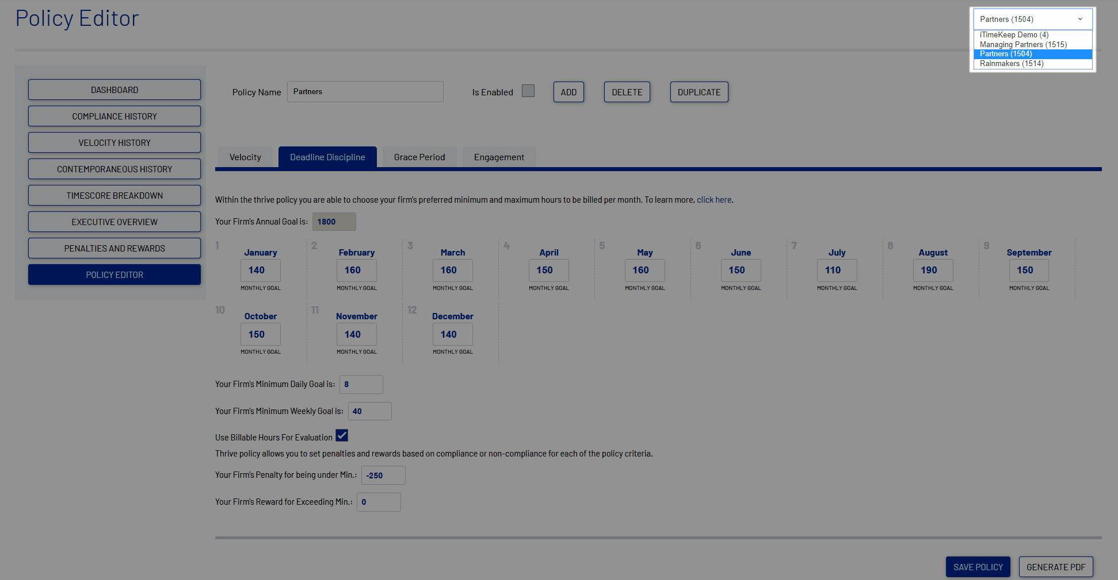
Multi-policy Management
Create bespoke goals for different groups of timekeepers in your organization
Create multiple policies for each employee category – e.g. title/rank
User can only be assigned to one (1) policy
Set Annual and Monthly Goals
Weekly and Monthly Grace Days to track delinquent time
Note: Users are assigned to a policy in iTimekeep Portal > Thrive > Manage Users
Notes:
internal

Slide 25
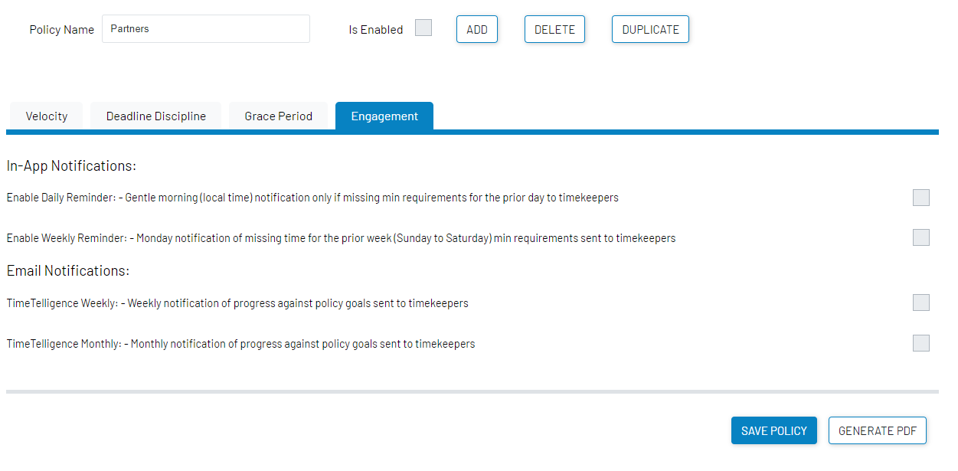
Engage with Timekeepers & Policy Owners
Guide Partners and Associates to become better timekeepers
By policy, firms can configure how to engage with policy members
In addition to availability of goals in iTimekeep Dashboard
Notes:
external

Slide 26
WHAT’S NEW
Thrive - Demo

Slide 27
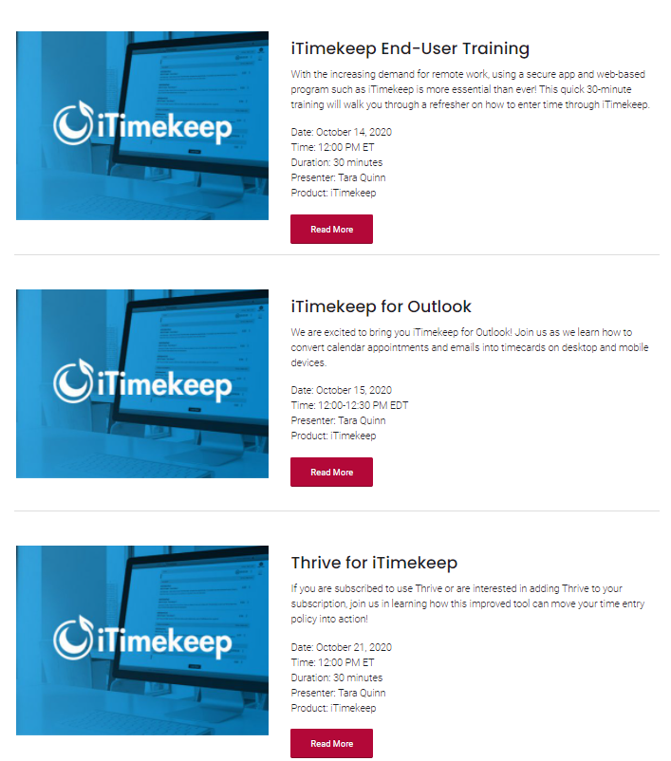
Trainings
Upcoming training for iTimekeep and Admin trainings
Share the word about end-user training
Join us for Admin training in Thrive, OCG Live or iTimekeep Portal
Classes can be found at www.aderant.com/client-webinars-itimekeep/
Notes:
external

Slide 28
October Release Date
Upcoming release date for iTimekeep, OCG Live, & Thrive
The new features will go live on October 10th.
Please visit our resources page for the
Attorney Communication Template
FAQ
…and more!
Notes:
external

Slide 29
Questions?
Visit resources.goaderant.com/ for more resources and be sure to reach out to your account manager or customer support representative if you have any questions.
You can also contact us directly at
iTimekeep_Account_Manager@aderant.com
or
iTimekeepSupport@aderant.com

