Slide 1
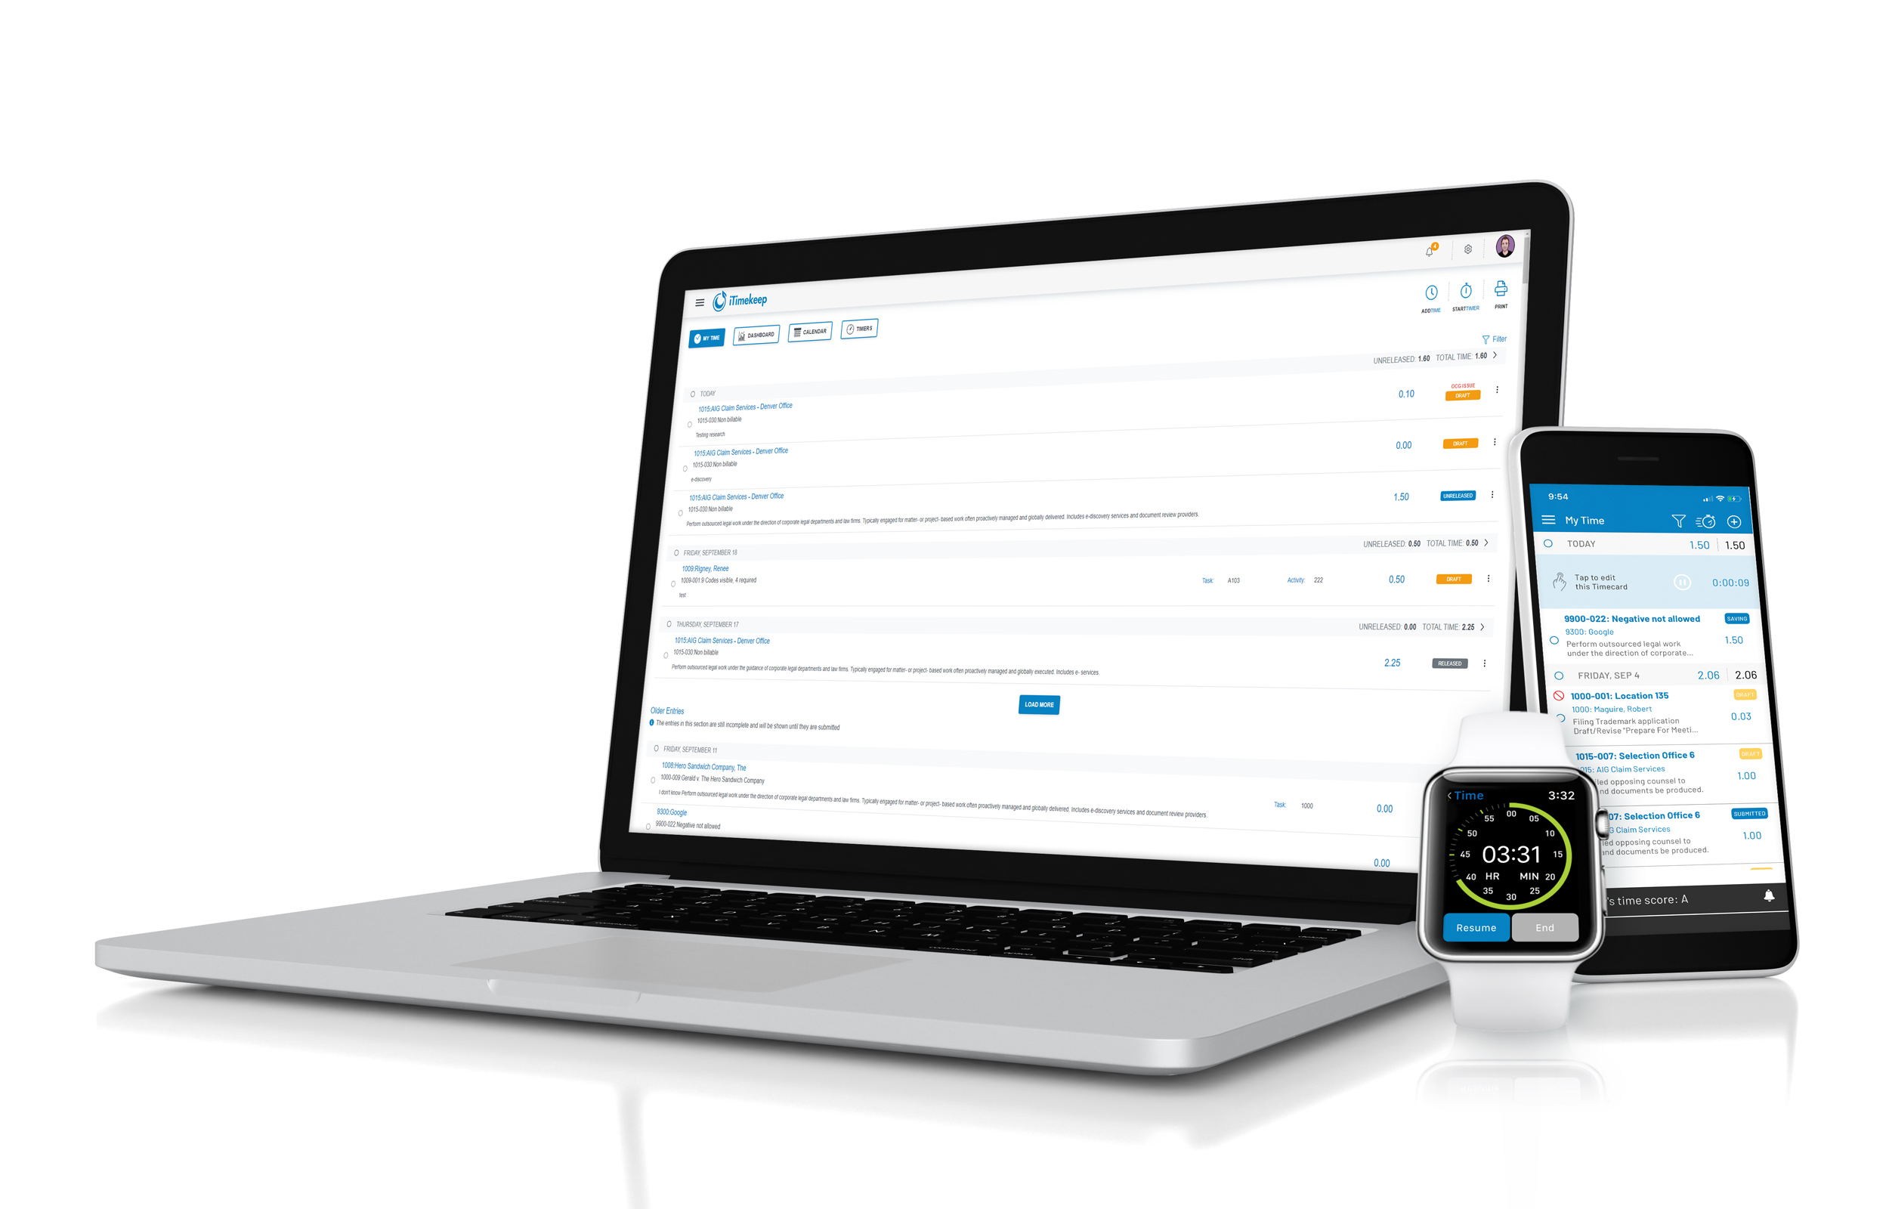
Resource Materials OCG Live™
April 2021 Product Release

Slide 2
Our Vision:
Access and enforce guidelines through flexible staffing, assignment, and streamlined communication

Slide 3
C-Level & Finance Professionals
Ensure compliance and at-risk revenue is protected by establishing an efficient process where violations are corrected by the proper person within the organization

Slide 4
IT Professionals
Gain ease of user management
Enforce security – and save time doing it
Minimize the need for manual work or repetitive data entry

Slide 5
Lawyers
Access to OCGs ensures you are always "in-the-know."
Lawyers are working with multiple clients with unique sets of billing rules and obligations that make it difficult to keep track.

Slide 6
WHAT’S NEW
OCG Live™

Slide 7
OCG Live: Release Highlights
Roles & Permissions Structure New OCG Live roles;
Timekeepers
Billing User
Billing Manager
----
Dept. Member
Guideline Administrator
Source Timekeeper-Biller Relationship from T&B*
Utilize the Billing User Role in rules for automatic task and/or violation assignment to the relevant individual
* Currently only available for Aderant Expert and Elite 3E
Enhancements to Rules, Actions, and Tasks
Create rules that last by assigning roles to rules
Identify where violations display
Enhancements to Violations Report
Violations are corrected by appropriate individual

Slide 8
OCG Live: Release Highlights
OCG Live Standard Enhancements
Additional capabilities for managing guidelines

Slide 9
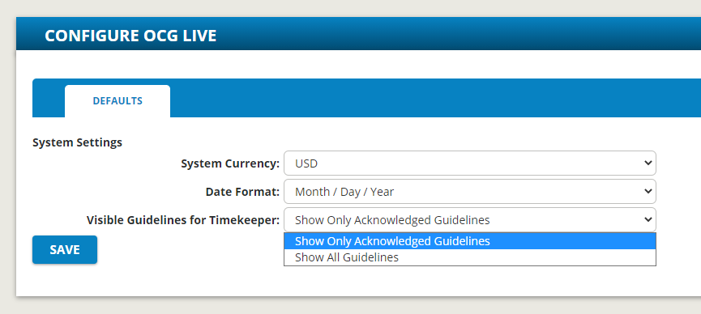
Roles & Permission
New Default roles
Billing Manager
Biller
Timekeeper
OCG Live – Professional
Determine visible guidelines

Slide 10
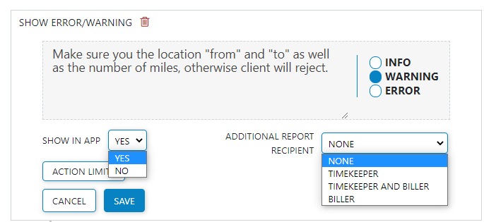
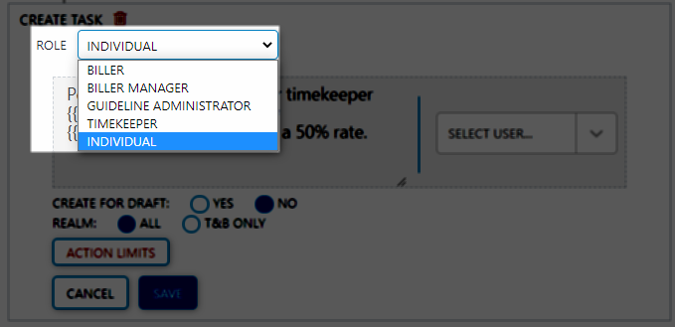
Enhancements to Rules, Actions, and Tasks
Create rules that last
Specify a Role for Tasks rather than an individual
Define where messaging displays
Notes:
Additional capability to assign tasks to a Role like Billing Manager or Billing user rather than an individual, so that ‘Create Task’ action becomes more ‘role’ oriented.

Slide 11
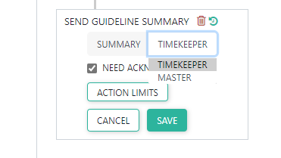
Enhancements to Rules, Actions, and Tasks
Create rules that last
Specify summary tab in actions
Notes:
Guideline Acknowledgement Enhancement:
Simple summaries are only useful if the attorneys can easily locate and access them.
Directs user to the summary most applicable to them.
Ability to specify Summary tab in actions
Landing page of the Guideline summary to be Timekeeper Tab by default, with option to choose from the available tabs in the Guideline Summary in Canvas.

Slide 12
Enhancements to Violations Report
Violations corrected by individual responsible for compliance
Identify Report Recipient to receive Daily Violations Report email
Addition to Guideline Administrators

Slide 13
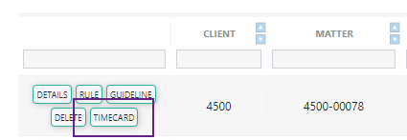
Enhancements to Violations Report
Violations corrected by individual responsible for compliance
Deep-linking: Replaced by hyperlinking the Timecard ID
Report Improvements:
Renamed Columns to be more intuitive
Additional Status column
Ability to generate Timeframe violations report for specific timekeeper

Slide 14
Timekeeper Access to Violations Report
Access to the Timeframe Violations Report
The report is only '@ME' - timekeeper can only see their own violations.
Timeframe report automatically populates data for Month-To-Date selection.

Slide 15
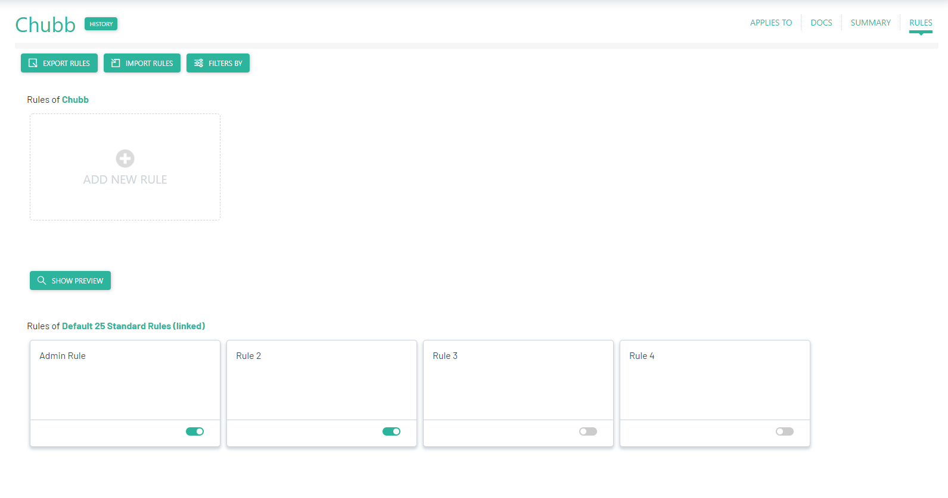
OCG Live Standard Enhancements
Add New Guidelines
Enable/Disable available rules
Add Client and Matter numbers for improved adherence to guidelines

Slide 16
Questions?
Visit resources.goaderant.com for more resources and be sure to reach out to your account executive or customer support representative if you have any questions.

